Slide 1


Farmers
Conservationists
Ben Gregory
Cheshire Wildlife Trust

Slide 2
2015
Area Manager CWT
2007
Conservation Officer BASC
Volunteering
2012
Living Landscape Officer CWT
2002 - 2005
Bangor University BSc Environmental Conservation
2000
Harper Adams Agricultural College
Countryside Mgt.

Slide 3
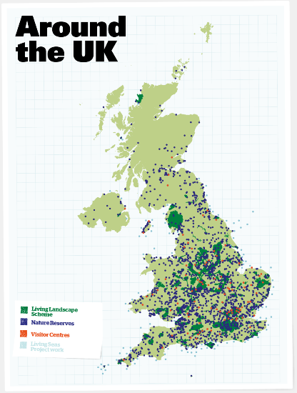
~10,000ha of nature reserves
150 coastal and marine reserves
150 living landscape schemes
13,000 events held each year
780,000 people directly engaged
8,200,000 visits to WT reserves
820,000 members
incl. 150,000 junior members
45,000 volunteers
2,600 staff (2,120 full time equiv)
600 trustees
Notes:
Cheshire Wildlife Trust is part of the UK wide Wildlife Trust movement:
The Wildlife Trusts are a movement of 800,000 members, 40,000 volunteers, 2,000 staff and more than 600 trustees associated with 47 individual charities. We believe that wildlife, wild places and the natural world are important, and work together to take action for them.
We work with people of all ages and from all backgrounds, in local places and within local communities across the UK.
We inspire people to connect with wildlife, wild places and the natural world where they live, empower them to stand up for it, enable them to take action for it in their daily lives, to understand it and demonstrate its value to society.
What RSWT do for the movement:
UK lobbying and advocacy
UK Communications
High level relationships with partners
Promote collective working
Organise seminars and conferences
Help and advice Trusts
Provide financial support in tough times
Manage grant funds we can access

Slide 4
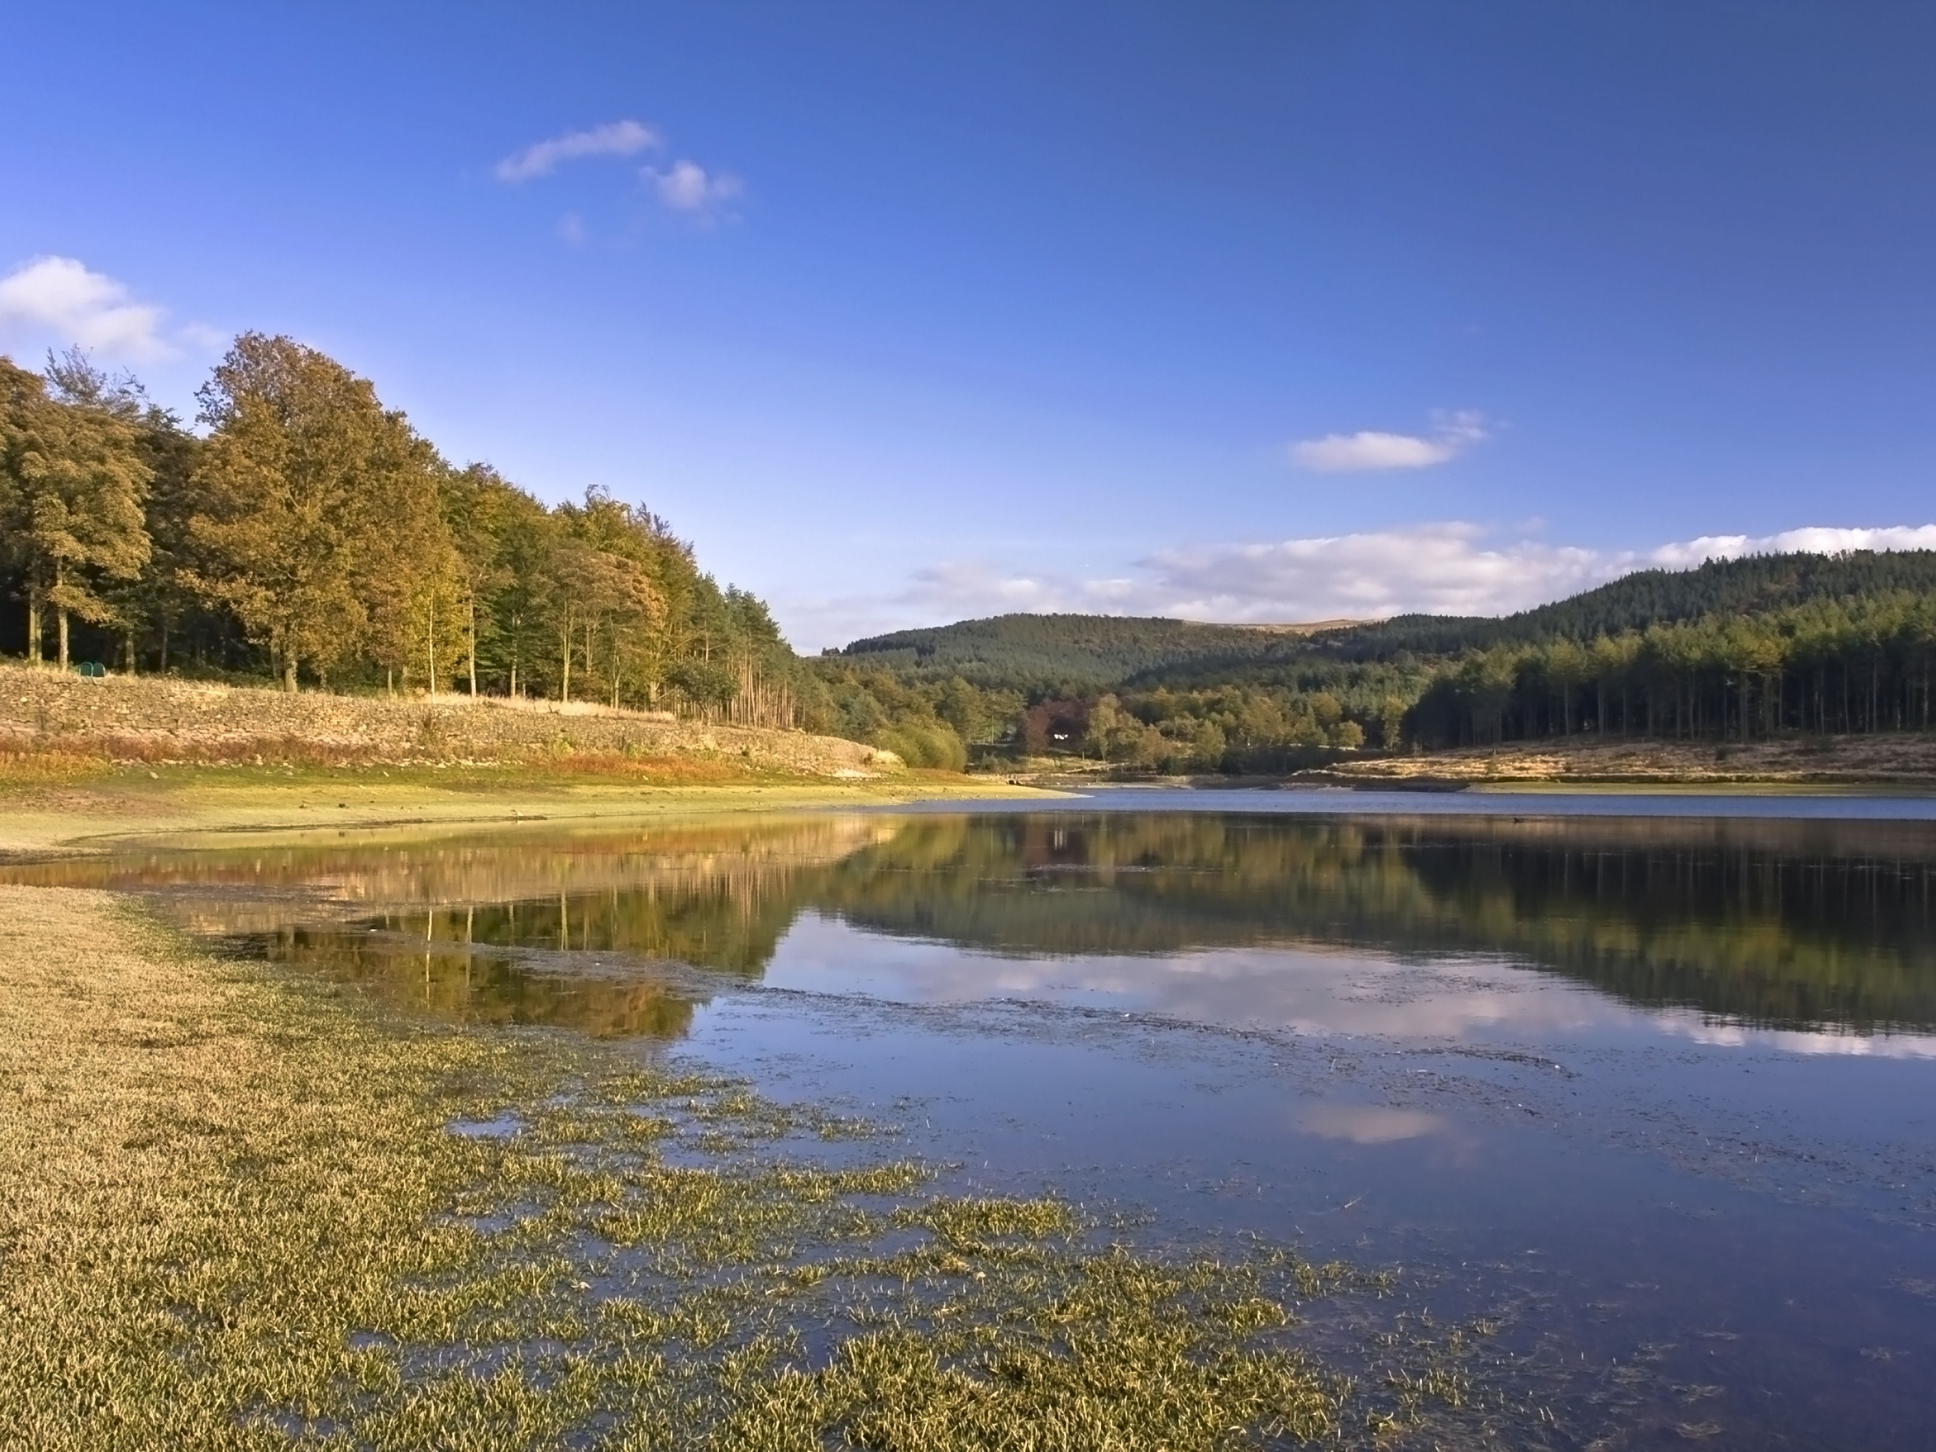
In a generation,
wildlife has more space to thrive and
more local people value nature
Notes:
Q to audience- what is a wildlife trust and what does it do?
What is Cheshire Wildlife Trust?
Formed in 1962, by volunteers, CWT is one of 47 independent charities which together form the UK wide Wildlife Trust movement.
We are the leading independent conservation organisation dedicated to protecting the wildlife and wild places within the Cheshire region, including Cheshire West & Chester, Cheshire East, Halton, Stockport, Tameside, Trafford , Warrington, and Wirral.
Our purpose is to create and conserve space for local wildlife that is enjoyed and valued by all
(picture- CWT nature reserve, Trentabank in Macclesfield Forest- home to one of Cheshire’s largest heronries)

Slide 5
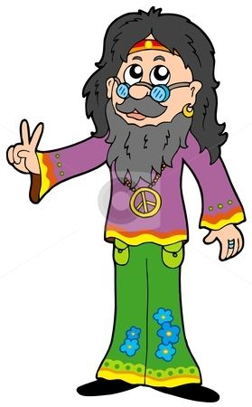
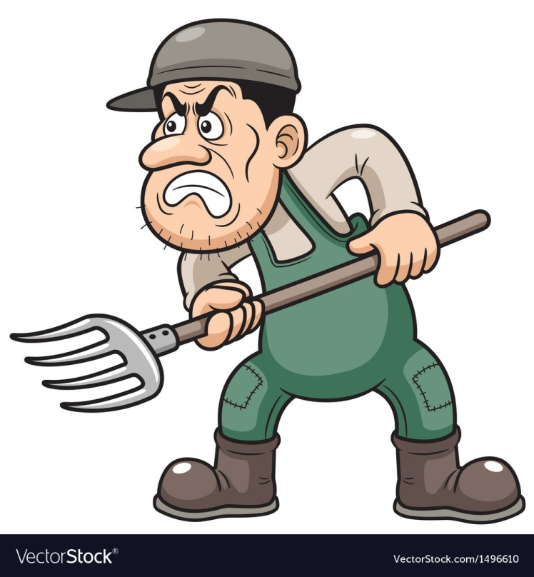
Why work with farmers?

Slide 6
590 : 250,000

Slide 7
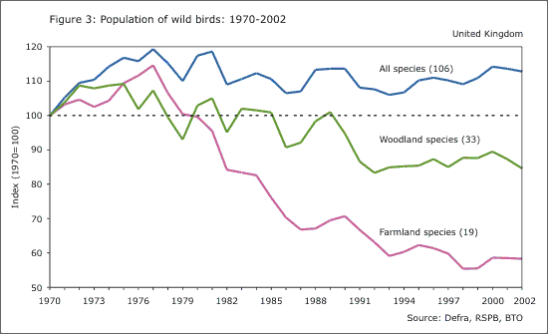

Slide 8
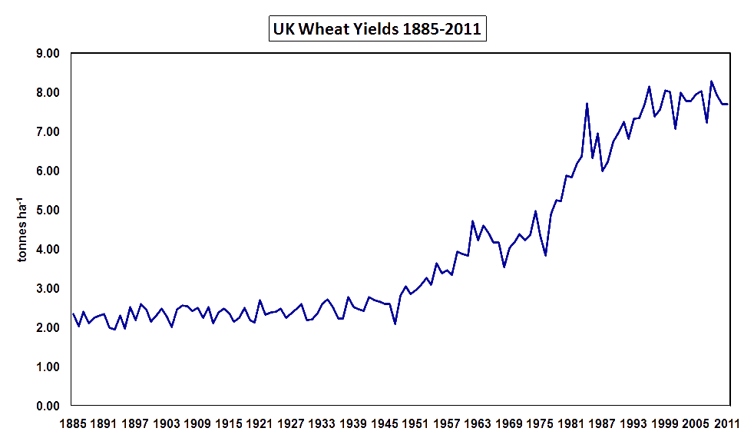

Slide 9
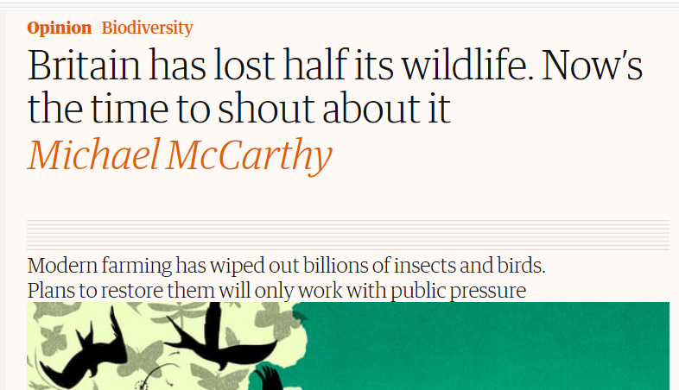
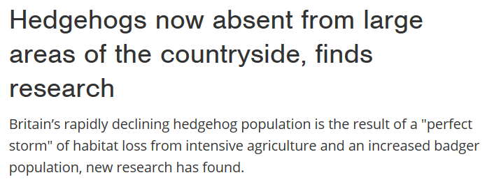
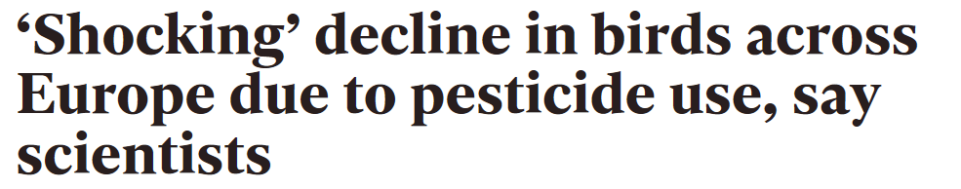
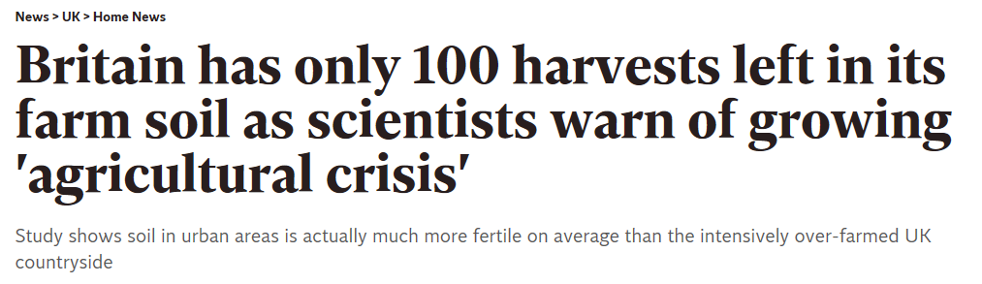
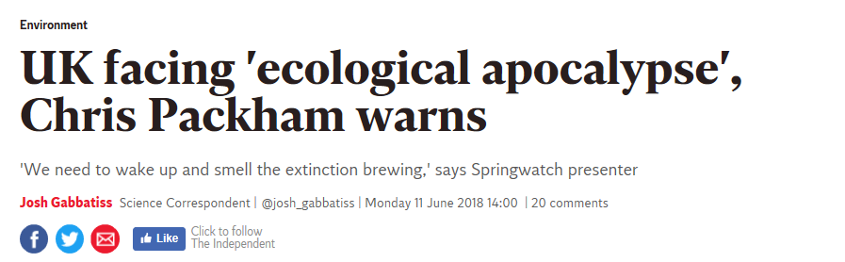

Slide 10
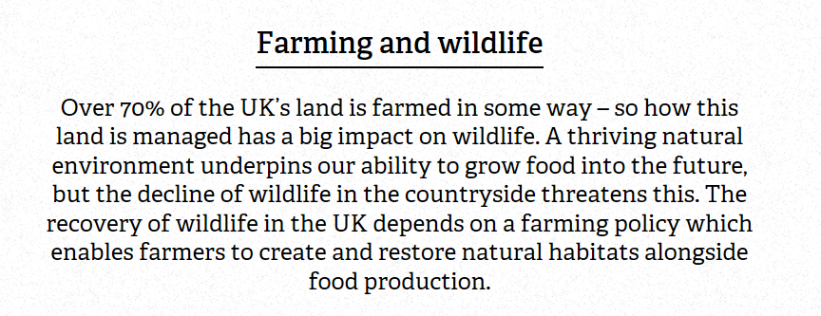
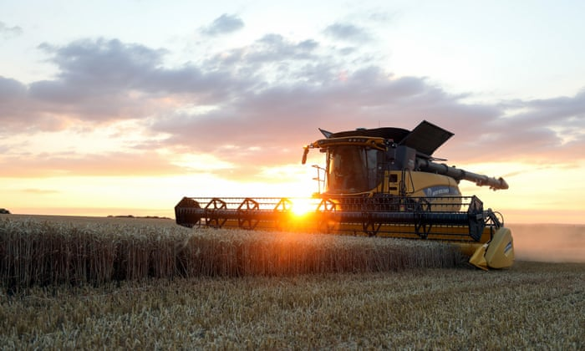

Slide 11
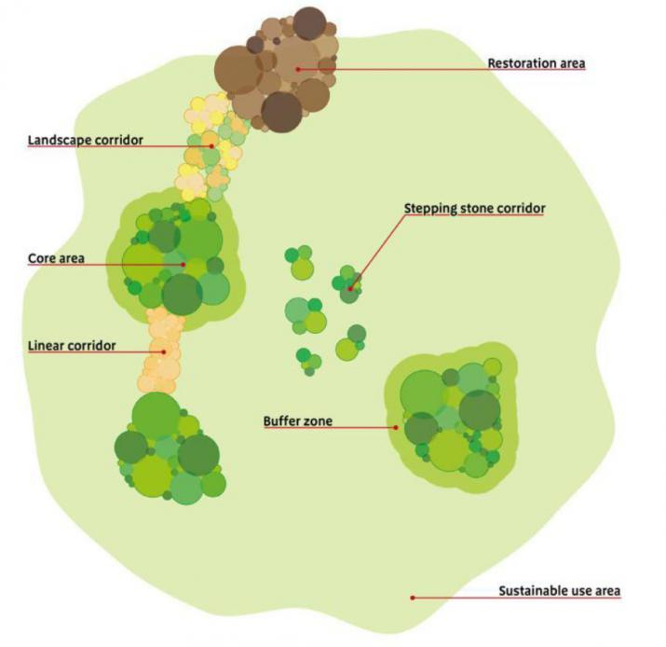
Making Space for Nature:
A review of England’s Wildlife Sites and Ecological Network
“There is compelling evidence that England's collection of wildlife sites are generally too small and too isolated, leading to declines in many of England's characteristic species,"
"With climate change, the situation is likely to get worse. This is bad news for wildlife but also bad news for us.
"The damage to nature also means our natural environment is less able to provide many of the services upon which we depend. We need more space for nature."

Slide 12
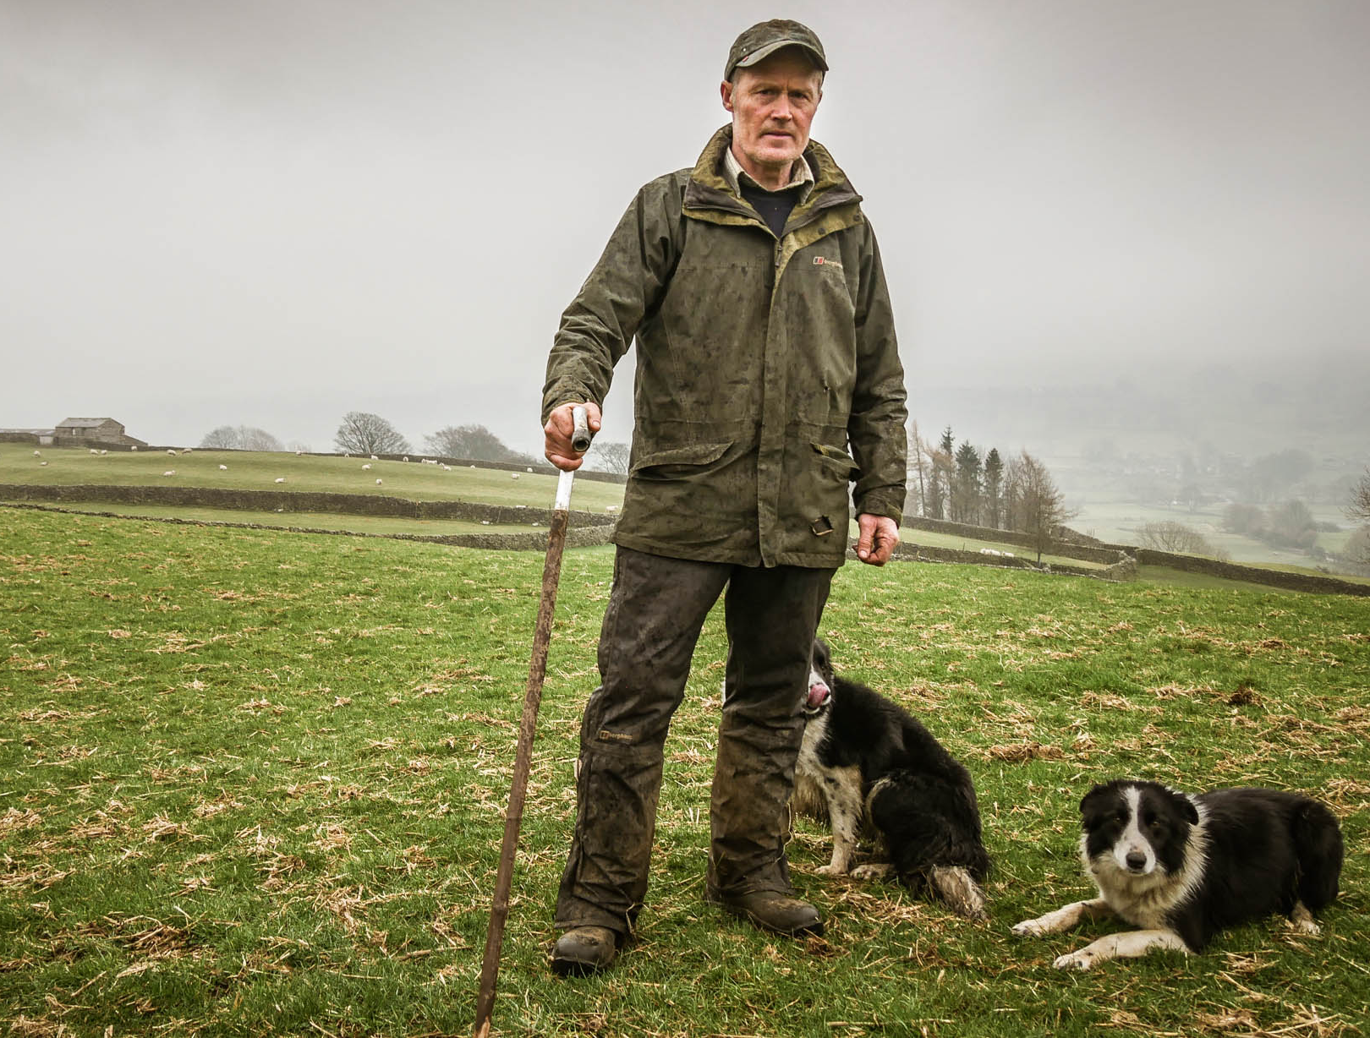
CWT’s work with farmers/ land managers
Influencing agricultural policy
Advice & Guidance
Demonstrating best practice
Living Landscape projects
Partnership projects

Slide 13
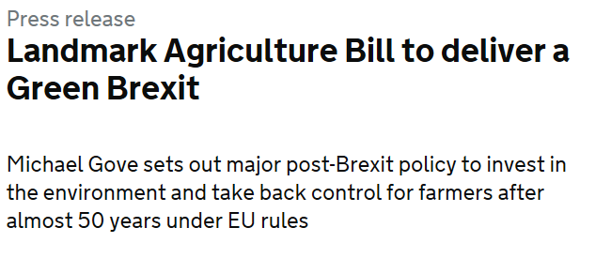
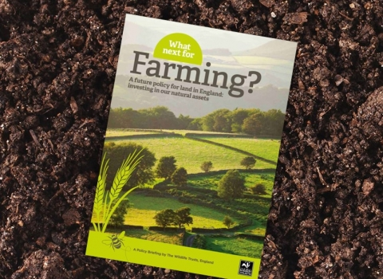
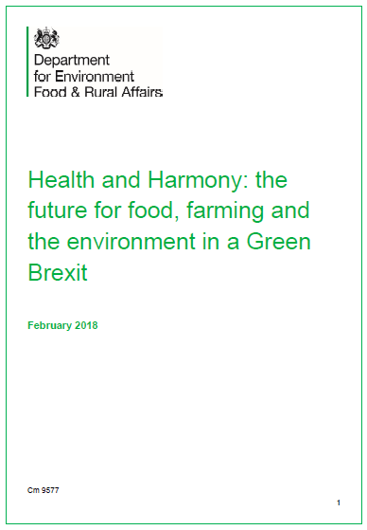
Influencing agricultural policy
Health & Harmony The future for food, farming & the environment
Agriculture Bill
What next for farming?

Slide 14
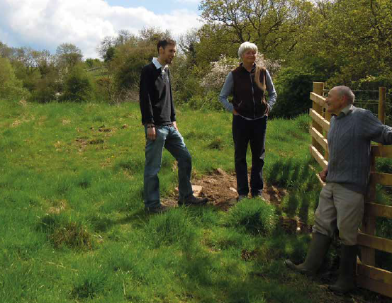
Advice & Guidance
Agri- environment scheme advice
Habitat and species management advice

Slide 15
Demonstrating best practice at Bickley Hall Farm

Slide 16
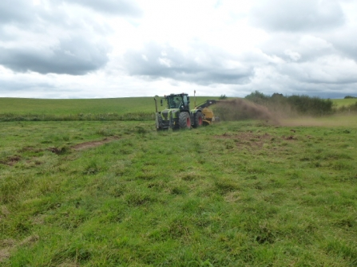
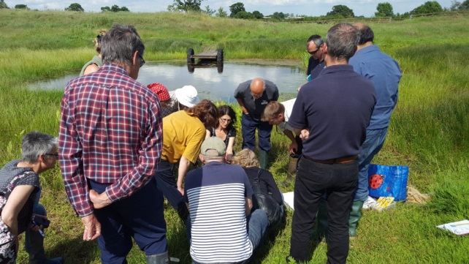
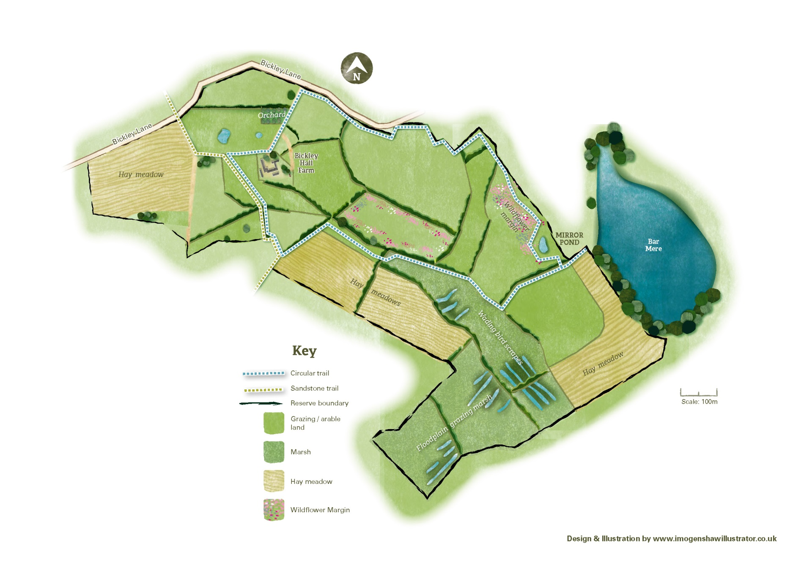
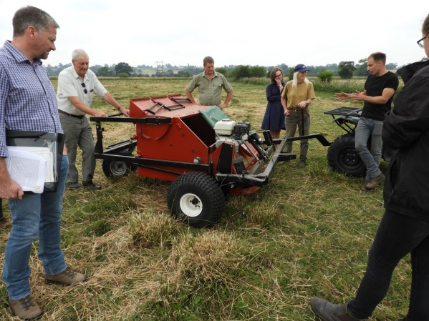
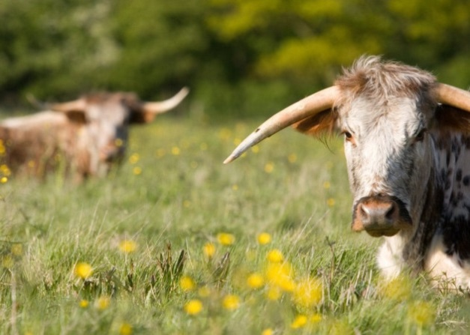
Demonstrating best practice

Slide 17
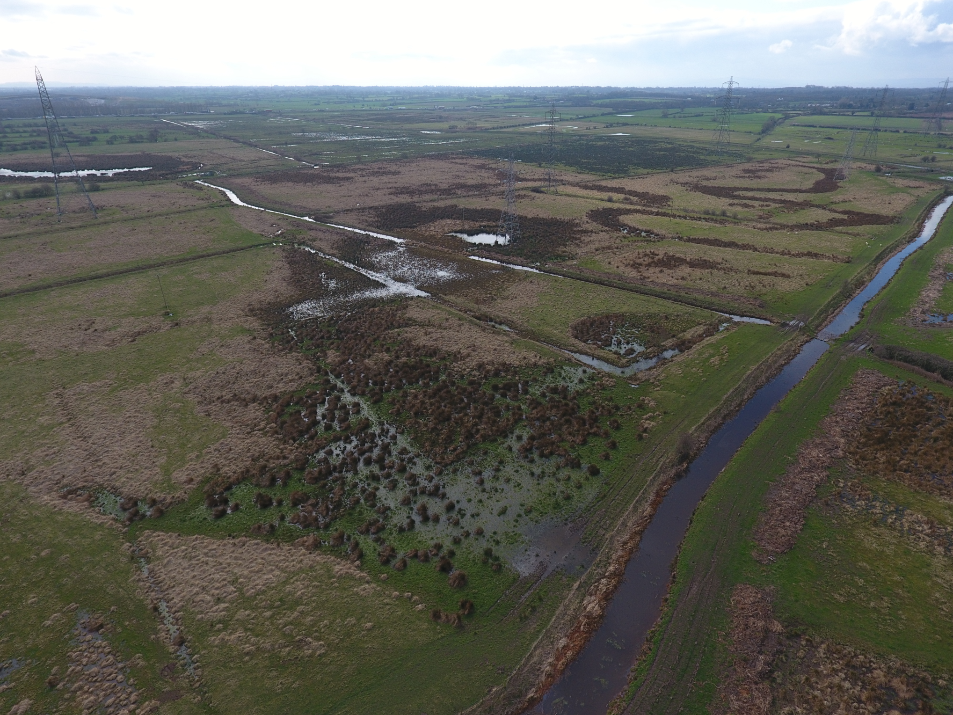
Living Landscape projects – Gowy Connect
Worked with 8 landowners to enter them into environmental stewardship schemes including 4 ELS and 4 HLS. Work includes:
Restoring wet grassland for breeding wading birds
Creation of linear scrapes and ponds
Hedgerow restoration including coppicing, laying and planting
Maintenance of low input grassland for botanical features
Restoration of fen habitat
Over 12,000m of fencing erected to protect watercourses and hedgerows
Over 6000m of hedgerow created/restored
More than 43ha of lowland meadow brought into positive management
Over 140ha of floodplain grazing marsh restored/ brought into positive management

Slide 18
Living Landscape projects – Dane headwater facilitation fund

Slide 19

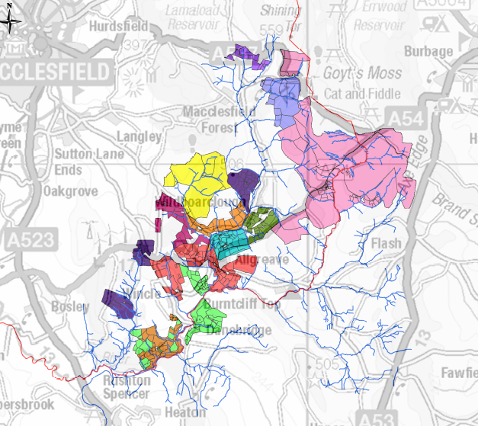
Living Landscape projects – Dane headwater facilitation fund
One of 96 farmer cluster groups across England
Working with 12 farmers over 2600 ha to:
Deliver training programme to improve awareness of priority habitats & species
Secure funding for biodiversity enhancement, water quality and soil health
Provide Countryside Stewardship advice

Slide 20
Partnership projects – Slowing the flow A natural solution to flood management

Slide 21
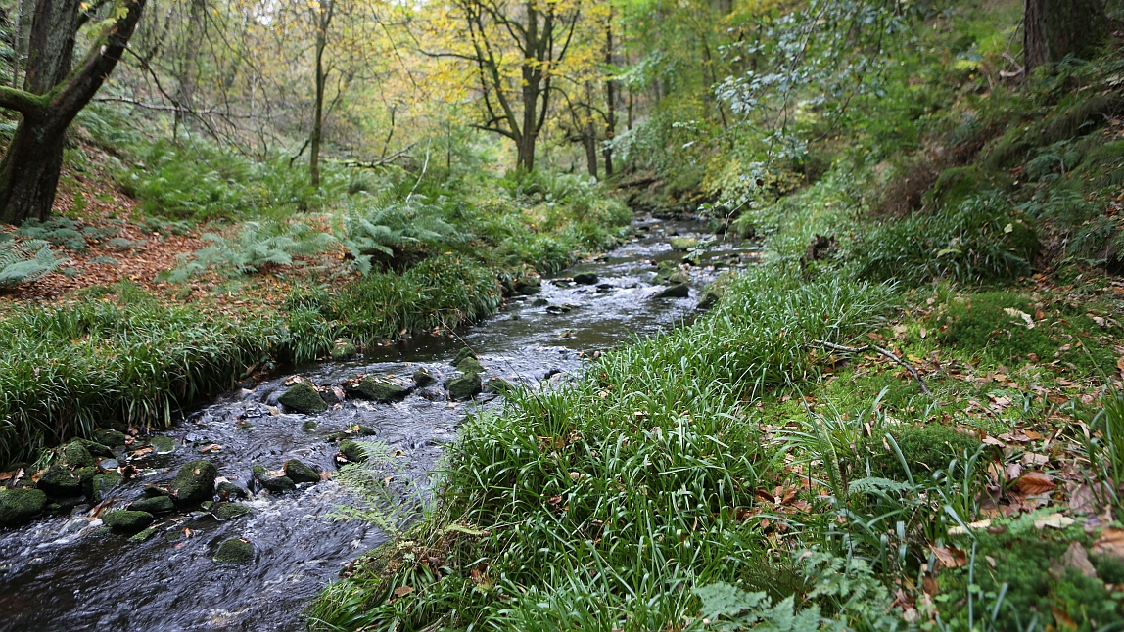

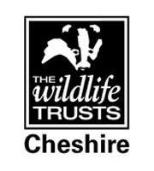




Partnership projects – Slowing the flow A natural solution to flood management

Slide 22
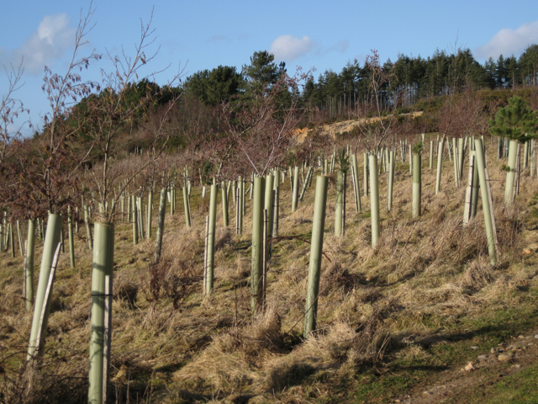
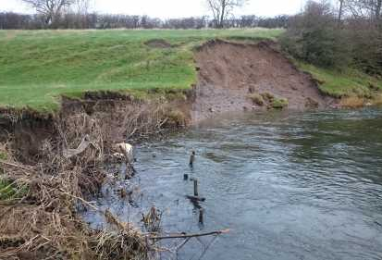
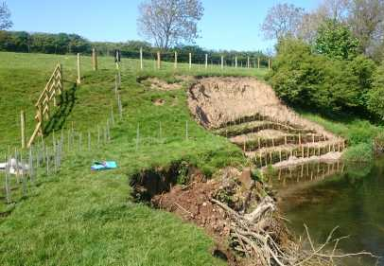
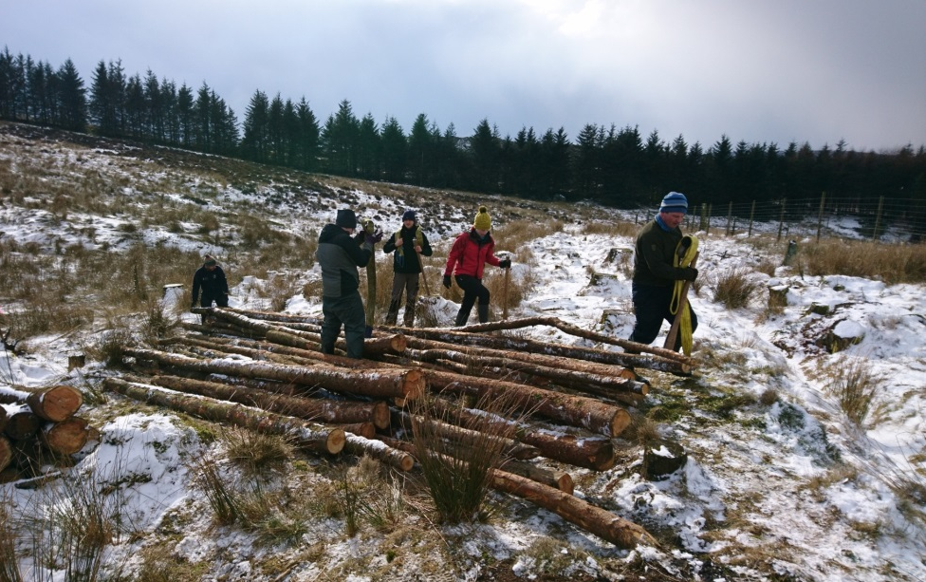
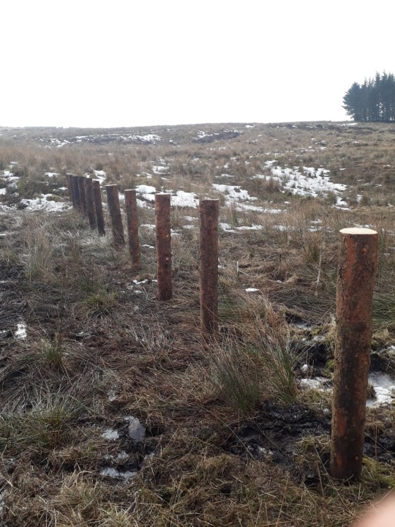
Woodland planting
Riparian buffering
Engineered log dams

Slide 23
Partnership projects – Dane valley Catchment Safeguard Zone

Slide 24

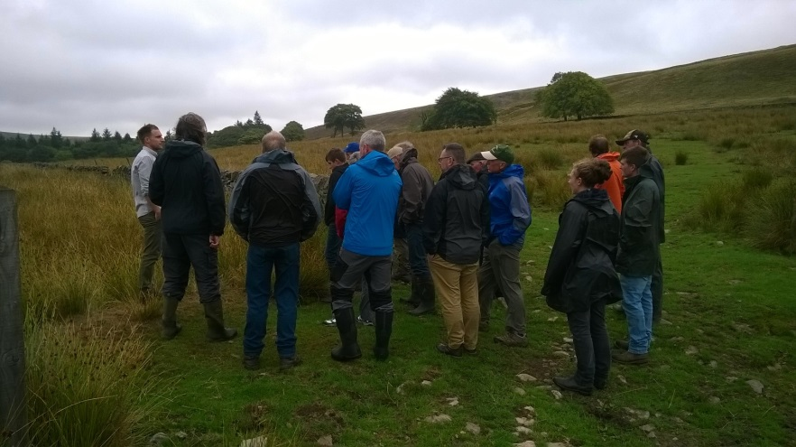
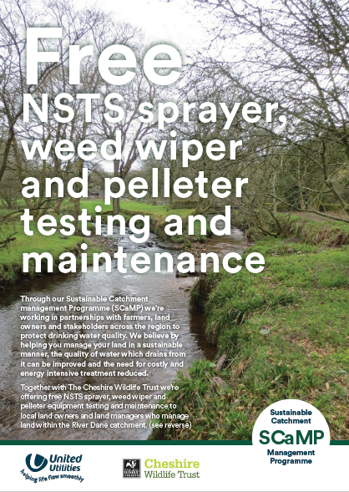
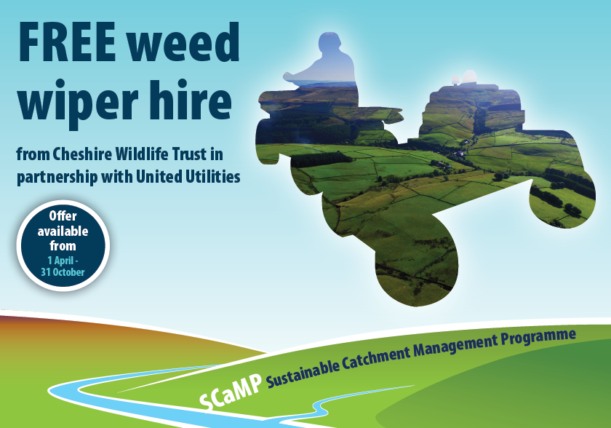
Partnership projects – Dane valley Catchment Safeguard Zone
Water quality monitoring
  Pollution incidence recording
  Passive sampling (chemcatchers)
  Exceedance investigation
Raising awareness on water quality
  Farm visits and newsletter
  Engagement with agricultural suppliers
  Water quality pollution incidents
  Facilitating events and workshops
Implementing advice and support
  Capital works projects
  PA Training
  NSTS Tests
  Slug pellet switch scheme

Slide 25
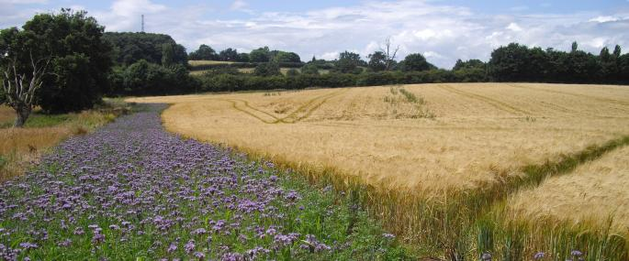
Ben Gregory
Area Manager South
Cheshire Wildlife Trust
bgregory@cheshirewt.org.uk

