Slide 1
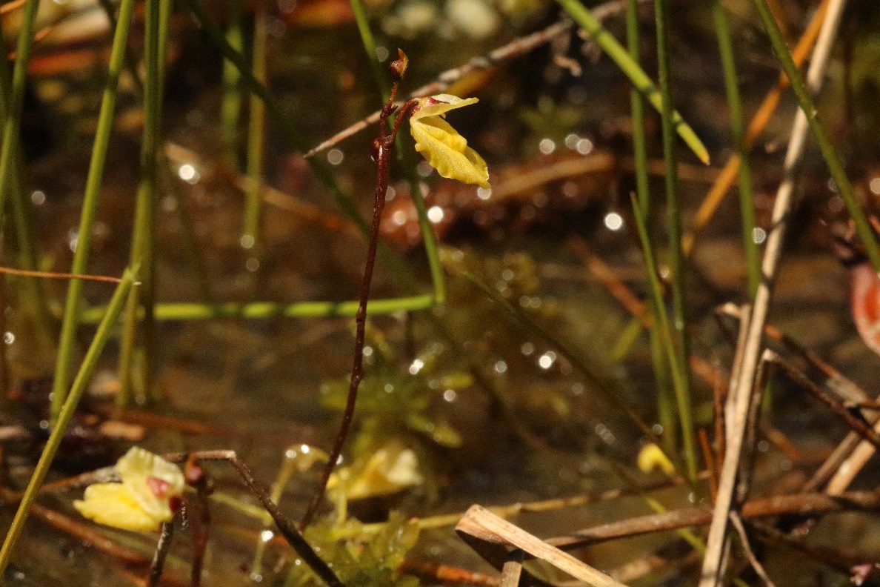
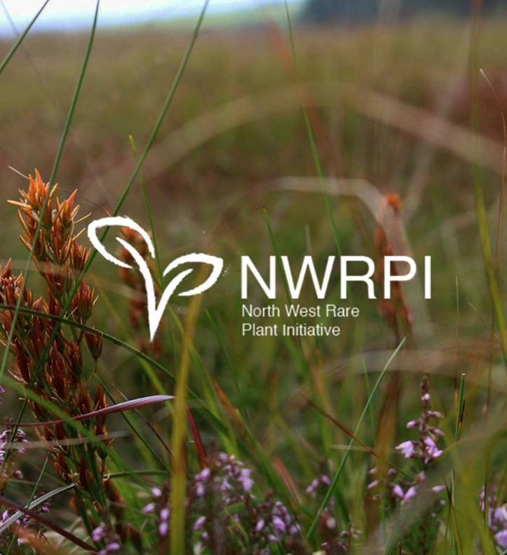
The North-West Rare Plants Initiative www.nwrpi.weebly.com
Joshua Styles

Slide 2
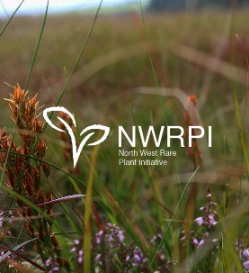
‘But why plants?...’
Plants are the fundamental basis of all life on earth!
An exceptionally diverse group of organisms that employ an enormous array of adaptations for survival…

Slide 3
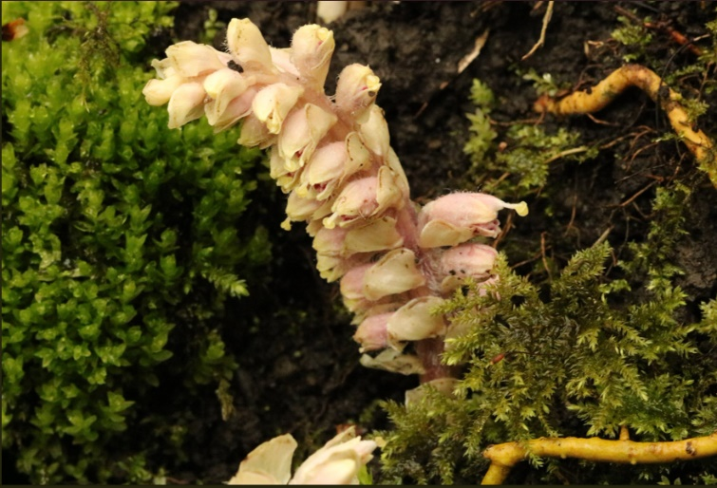
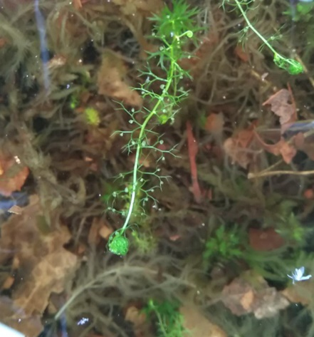
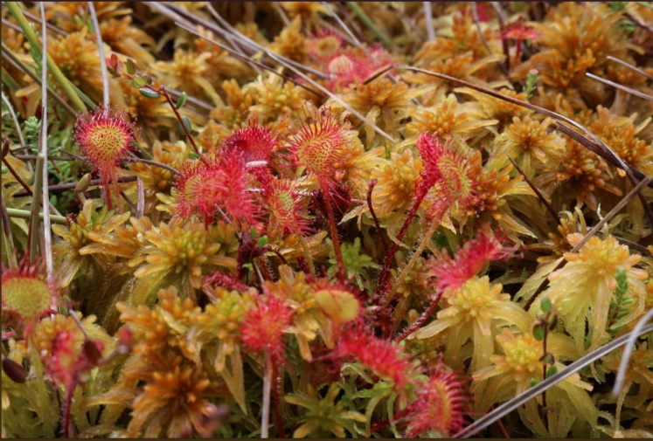
Toothwort (Lathraea squamaria)
Lesser Bladderwort (Utricularia minor)
Round-Leaved Sundew (Drosera rotundifolia)

Slide 4
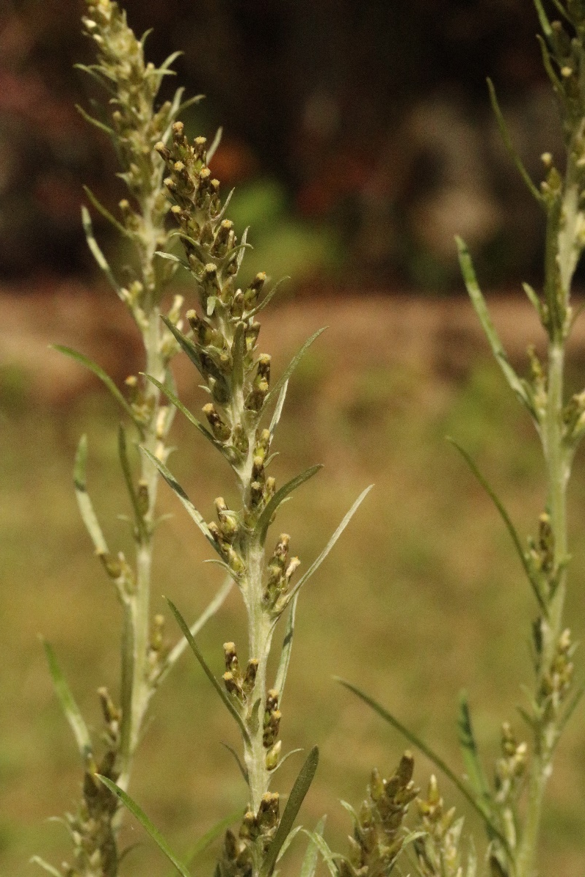
Heath Cudweed
(Gnaphalium sylvaticum)

Slide 5
History
Developed and formalised in August 2017 on the basis of significant declines of target plants in recent times.
Obtained a partnership with Chester Zoo within two months of establishment.
Over 15 years cultivation and botanical recording experience

Slide 6
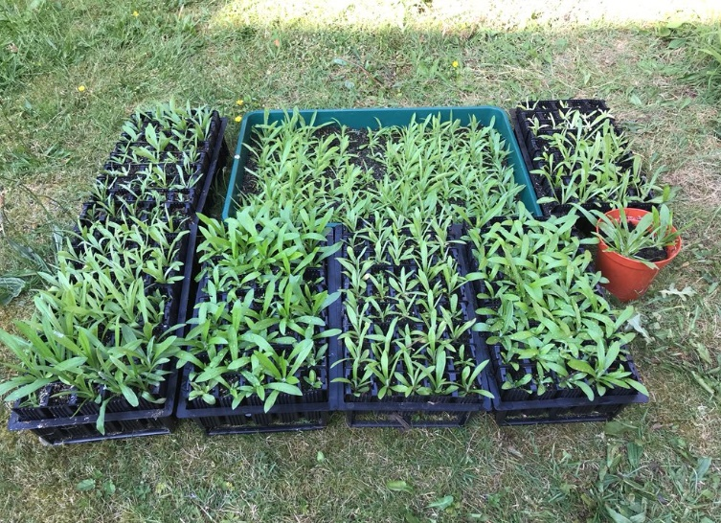
Aims
To establish ex situ populations of 49 regionally threatened plants with the ultimate goal of reintroduction/reinforcement where appropriate...

Slide 7
Aims
...it is a time-consuming process also involving:
Cooperation with landowners/land management
Collaboration with relevant conservation and statutory bodies (i.e. Natural England)
Establishment of a host of donor and receptor sites for each species
Provision of voluntary surveys (pre-introductory + post-introductory monitoring)

Slide 8


Funding
Partial funding from Chester Zoo
Partial funding from independent donors
Mostly self-funded from income resultant from ecological consultancy.

Slide 9



Gardening?
Justification for sampling and reintroduction is in accordance with IUCN & JNCC guidelines and the BSBI best code of practice.
Receptor site selection is a well thought through process...many questions must to be posed...

Slide 10
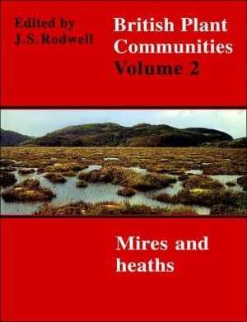
Gardening?
Is a site within the former range of the target sp.?
Are the factors that lead to the sp. extinction no longer applicable?
Is the site sustainably managed?
NVC survey data to determine
existing site botanical assemblage/s

Slide 11
Protocol
To view an overview of the protocol adhered to during sampling/reintroduction, see www.nwrpi.weebly.com for more details.

Slide 12

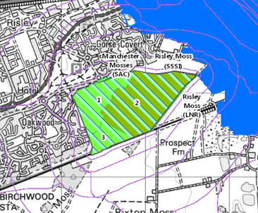
Case Study: Risley Moss SSSI
Restoration works began in the 1980’s from a dry, drained peatland.
Following re-wetting, Sphagnum mosses began to recolonise including species indicative of good quality peatlands such as S. papillosum and S. magellanicum.
Largest expanse of raised mossland determined to be in ‘favourable’ condition.
Historic records of a myriad of mossland specialists.

Slide 13
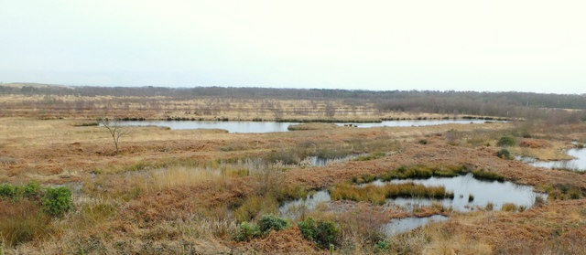
Case Study: Risley Moss SSSI
Suitability Assessment using the NVC
Two broad communities identified amidst the areas of best-restored mossland:
M2: Sphagnum cuspidatum/fallax bog pool
M18: Erica tetralix-Sphagnum papillosum raised mire

Slide 14
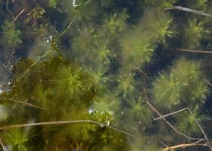
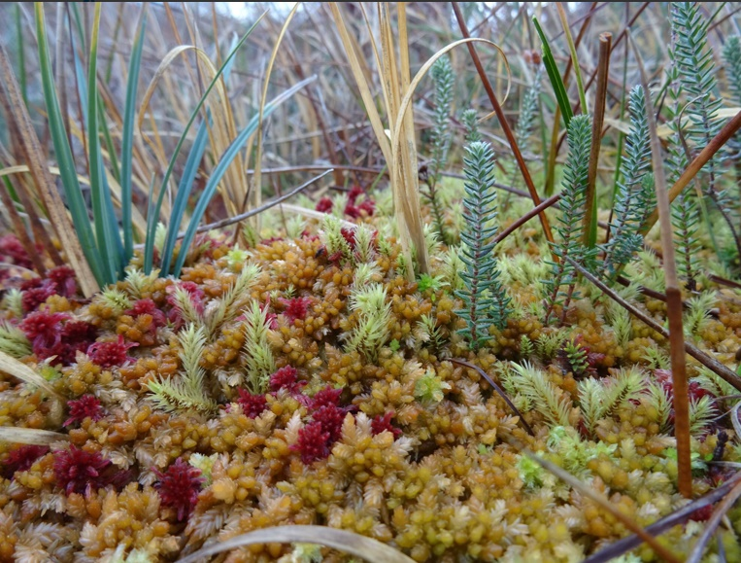
Case Study: Risley Moss SSSI
M2 Bog Pool
M18 Raised Bog

Slide 15
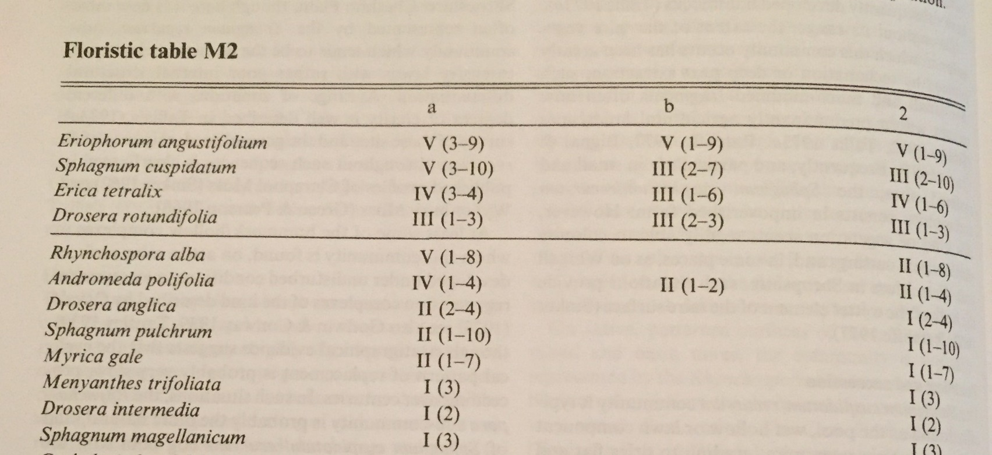
Notes:
Associates of M2 species highlighted = NWRPI priority species that were also extinct at Risley.

Slide 16
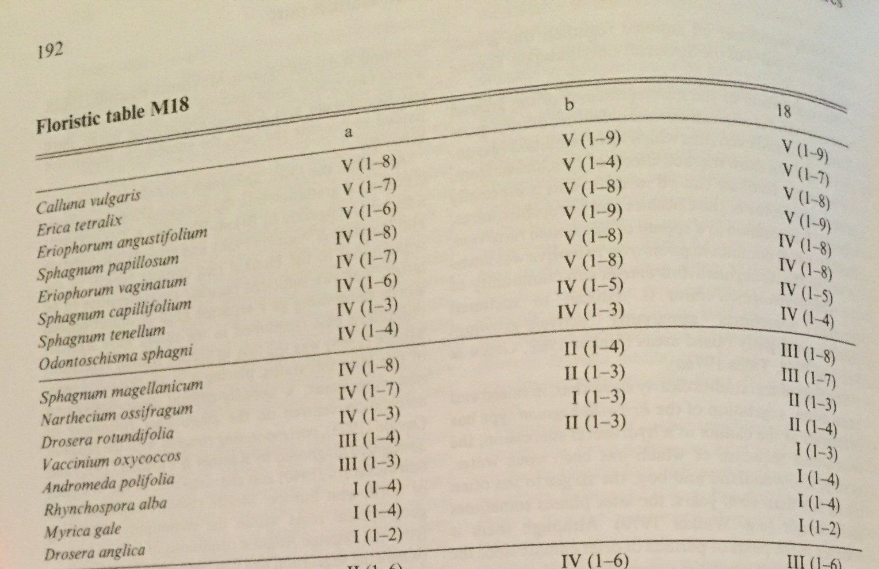
Notes:
Data on floristic associates of M2 and M18 communities was correlated with historic records. Key constituents of these communities were missing from extensive industrial activity which lead to the drainage of Risley Moss.

Slide 17
Case Study: Risley Moss SSSI
Limitations
Not all target species are listed associates of broad mire communities.
Data on common associates of particular species and reference to a species ecological niche are also considerations in suitability assessment.

Slide 18
Case Study: Risley Moss SSSI
Assessment and discussions resulted in the consent for reintroduction of:
Great Sundew (Drosera anglica)
Lesser Bladderwort (Utricularia minor)
Oblong-leaved Sundew (Drosera intermedia)
White Beak-sedge (Rhynchospora alba)
Notes:
D. anglica planned for next year

Slide 19
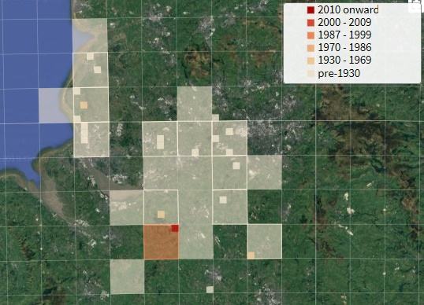
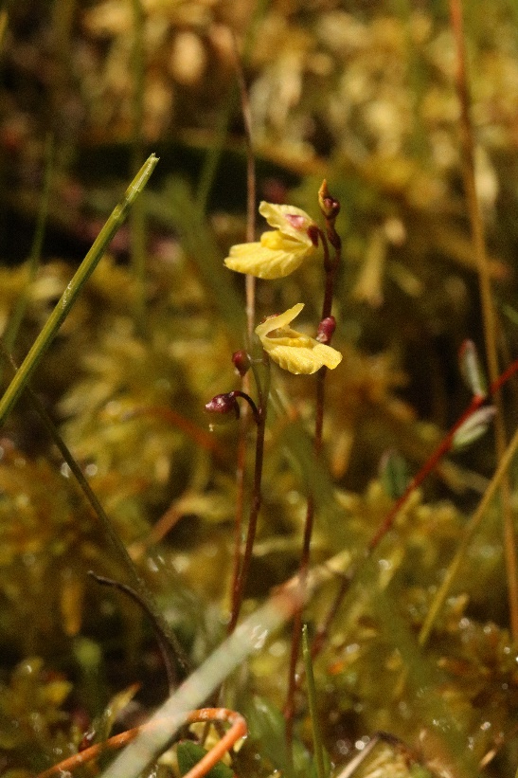
Case Study: Risley Moss SSSI

Slide 20
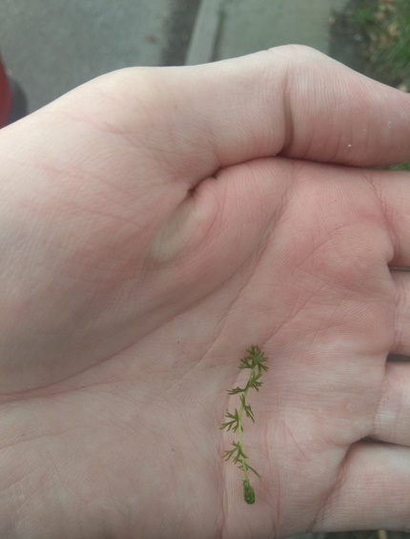
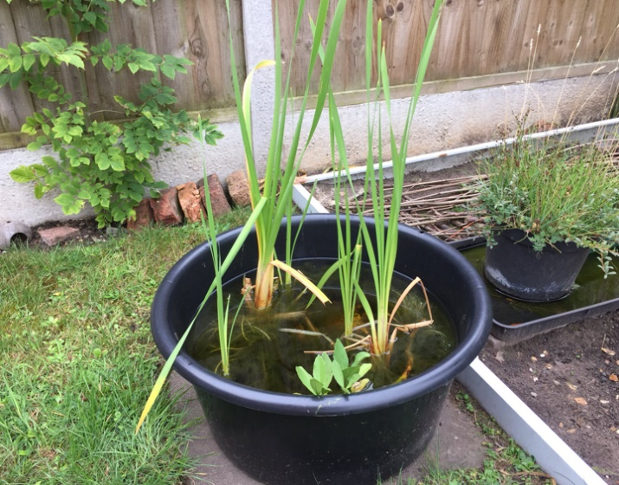
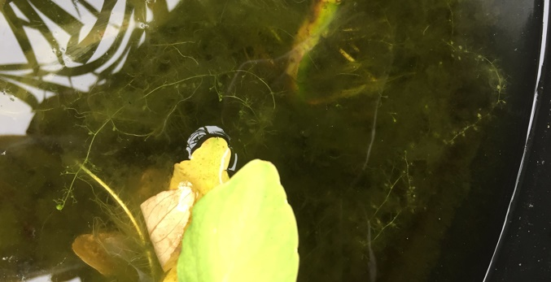
April 2018: Sampling
July 2018: 7 large aquatics set-ups colonised by the species.

Slide 21
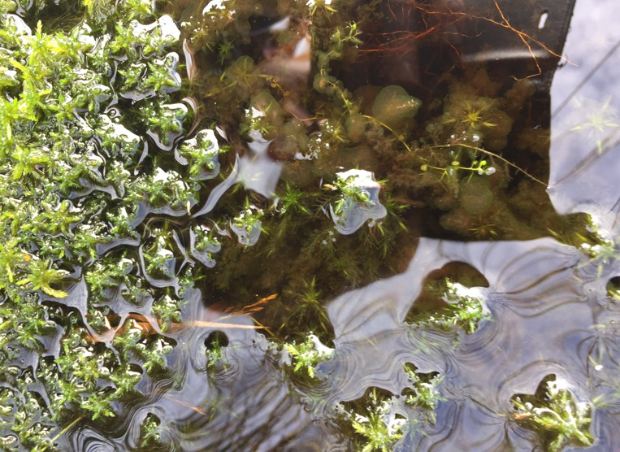
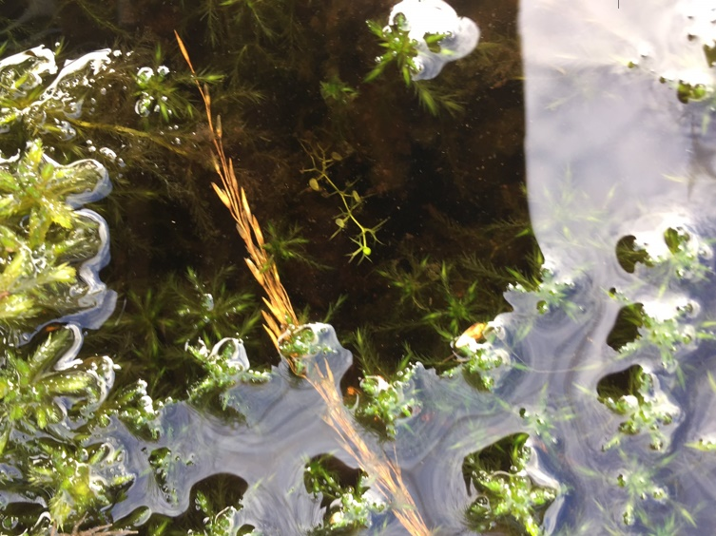
Case Study: Risley Moss SSSI
Lesser Bladderwort
Introduced across the margins of two permanently inundated pools at Risley during August 2018.
By October, all strands had grown by >150% and all were well established amidst marginal Sphagnum.
Notes:
Source population from Cheshire. Plants were grown at home and grew almost exponentially in cultivation. From 5 strands, I now have 7 tanks full of it.

Slide 22
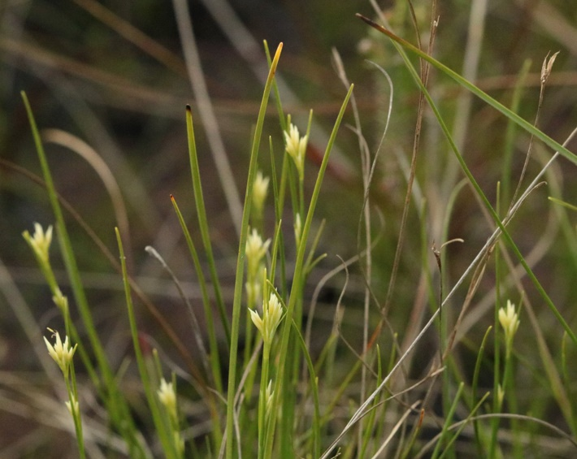
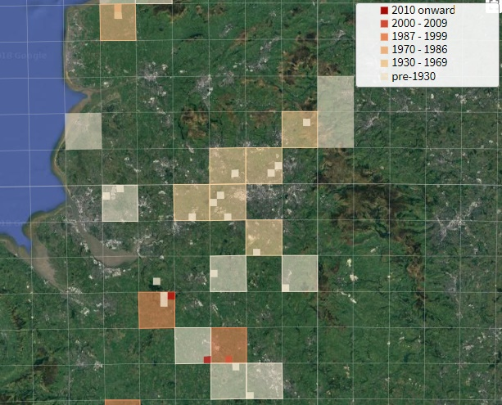
Case Study: Risley Moss SSSI

Slide 23
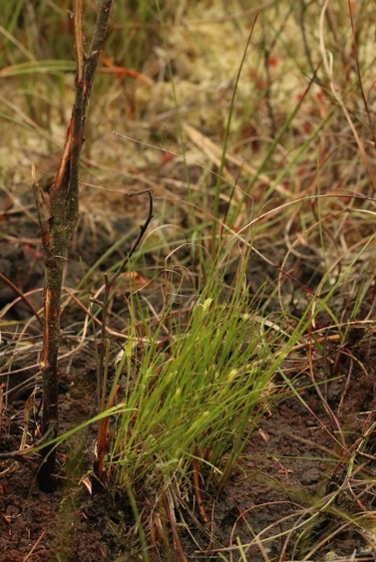
Case Study: Risley Moss SSSI
White Beak-sedge
Three clods approximately 5cm in diameter translocated from Abbots Moss SSSI onto Risley Moss during July 2018.
By September, all clods were noted to have increased in size.
Large number of fruits (nutlets) produced by all clods.

Slide 24
2018 so far…
Established ex situ populations of 42 of 49 target species.
Undertaken site suitability assessments for over 50 sites.
Has been involved in introductions and associated monitoring of 16 of 49 target species during 2018, following stringent translocation protocol, in accordance with IUCN guidelines, JNCC policy and BSBI code of conduct.
No failed/declining introduced population as yet, with marked success particularly with peatland specialists.
Collaboration with a myriad of NGO’s, Natural England and private landowners.

Slide 25
Finishing Notes
56% of Britain’s plants have suffered significant declines.
1 in 7 species threatened with imminent extinction.
On average, 1-2 plants go extinct in each county every year.
Regional extinction is often a pre-cursor to much wider-reaching extinction events…

Slide 26
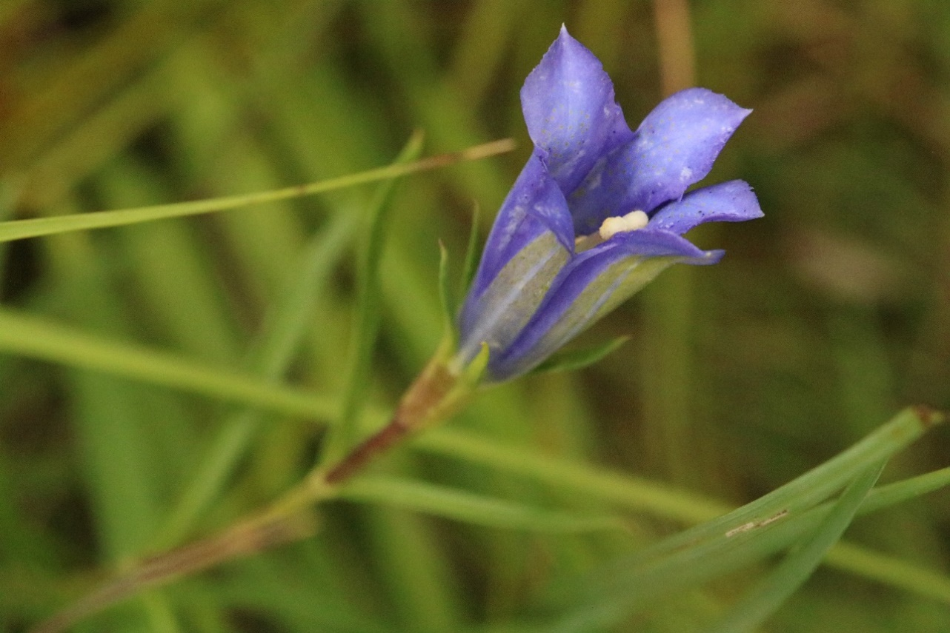
Questions

