Slide 1

A (profitable)
career as a
Nutritionist
Lessons and tips I wish I had known when I was sitting where you are now
(everything in blue & underlined can be clicked on for more info)

Slide 2







Introduction
Angela Clucas MSc SENr // Next Level Nutrition Ltd
Qualified and registered
Nutritionist & Wellbeing Coach

Slide 3
Sports Nutrition LJMU
Exercise Metabolism
Drugs in Sport
Fundamental Nutrition Skills
Practical Nutrition
Research Project
– Opportunities to work with PhD students on big projects
“Low pre‐exercise muscle glycogen availability offsets
the effect of post‐exercise cold water immersion in augmenting
PGC‐1α gene expression”
https://physoc.onlinelibrary.wiley.com/doi/full/10.14814/phy2.14082
Placement
- Huddersfield Giants
Also: Man City, Team Sky, Liverpool, Everton, Team GB athletes

Slide 4
What does a full time online nutritionist do?
Monday: Client reviews all day
Tuesday: Client reviews and follow up messages
Wednesday: Follow up messages, zoom calls
Thursday: Schedule social media for the week,
write blog & newsletter, zoom calls
Friday: Client Reviews, clear inbox
Weekends: 100% logged off

Slide 5
Other tasks
Accounts
Sales enquires
Social media replies
Writing presentations
General emails
Personal development
Free stuff for promo*

Slide 6
It wasn’t always like that…
2016
2021
No idea how to manage a diary
Strict schedule
Would accept appointments
7 days a week at any time
Use calendly to schedule calls
No email list
Email list weekly
No personal development
Always learning and developing
No idea if I was making money!
Just bought a house
What changed?

Slide 7

Systems
How to do what you do
FREE STUFF
PAID STUFF
GOOGLE DRIVE
SPECIFIC SOFTWARE
MYFITNESSPAL
NUTRITICS
SOCIAL MEDIA
PAID ADVERTISING
WOOFOO
SELF DEVELOPMENT
BOOKS/COURSES
CALENDLY
**FREE STUFF IS ALL
YOU NEED TO START**
PAYPAL*
STRIPE

Slide 8
ADVICE
If you remember anything from this talk, remember this:
Get involved in as much as possible at LJMU
You will need to be good with people,
good at communication –
if you need to work on this,
get a job which involves customer service
Know when to say yes or no
Start simple, which out for ‘gurus’

Slide 9
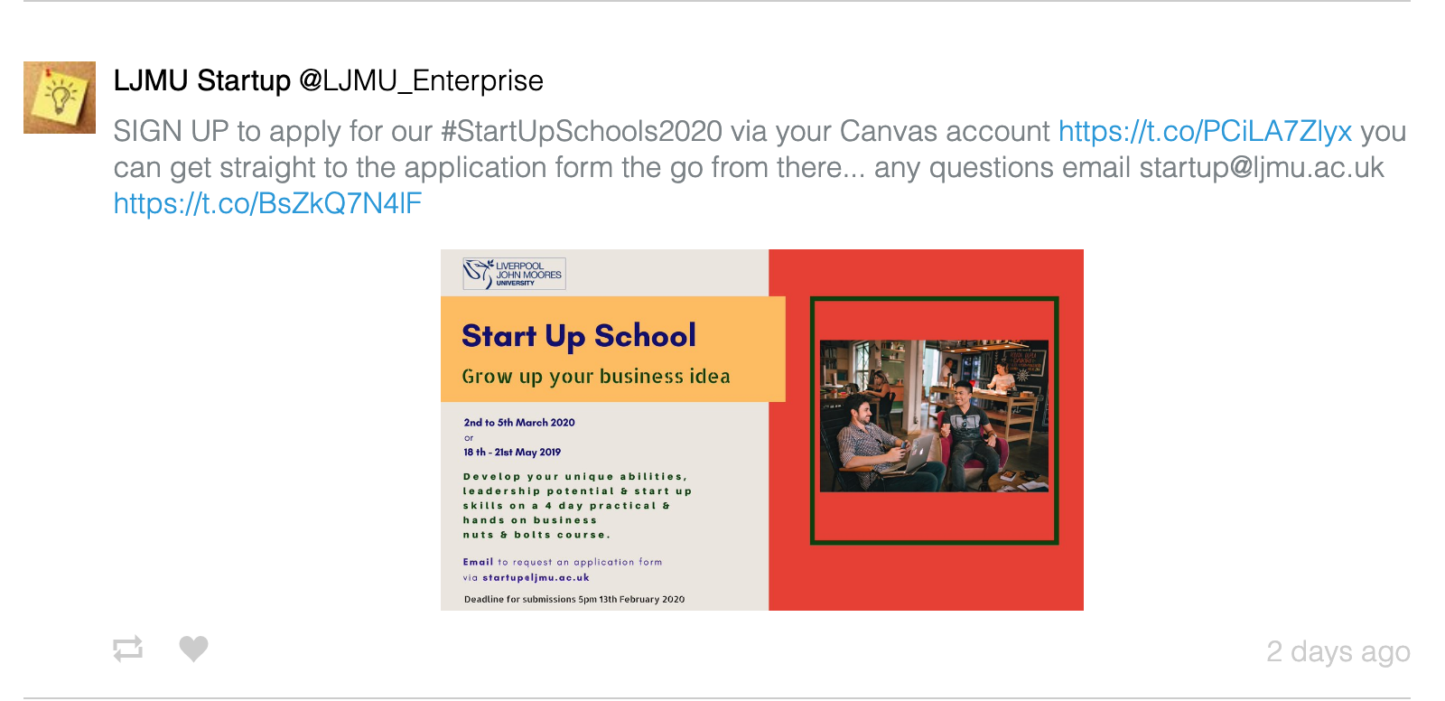
Centre for Entrepreneurship
Funding, Support, Networking
@LJMU_Enterprise

Slide 10
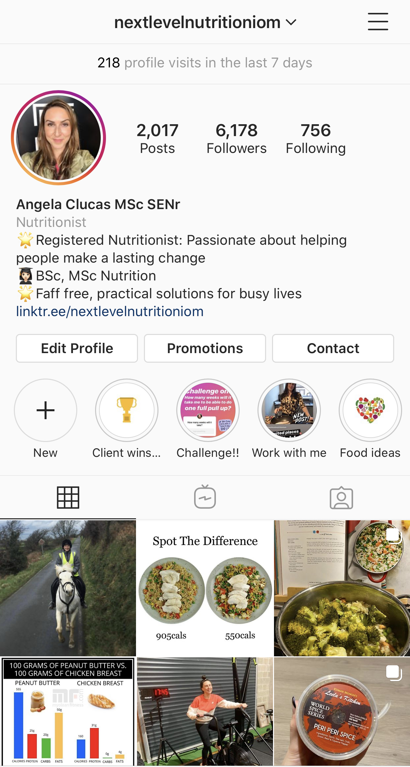
Questions?
Find me on social media
@nextlevelnutritioniom
Tell them what do do,
but not how to do it…
so they come to you for help
and to spend money
Give away your
best work for free!

