Slide 1

Life as a Registered Dietitian
Emma Langan
Diabetes Specialist Dietitian
St Helens and Knowsley NHS Teaching Hospital

Slide 2
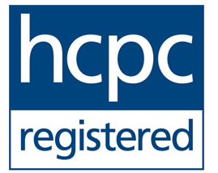
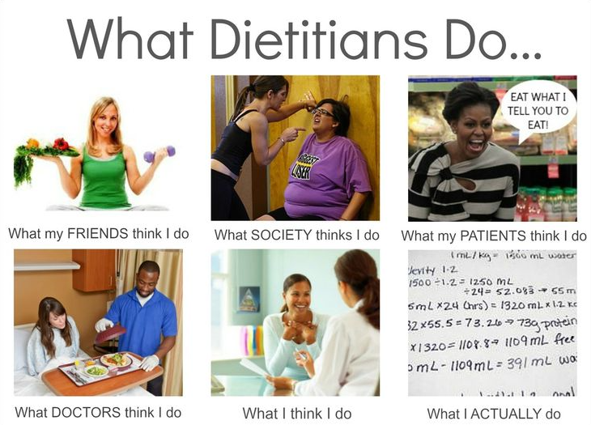
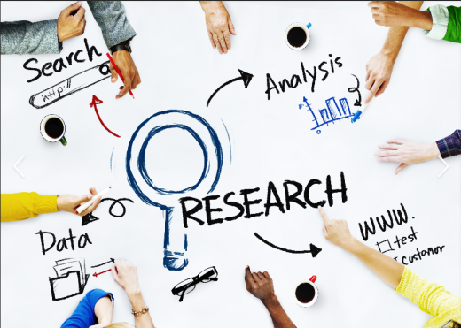
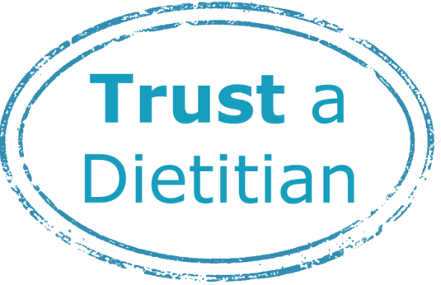
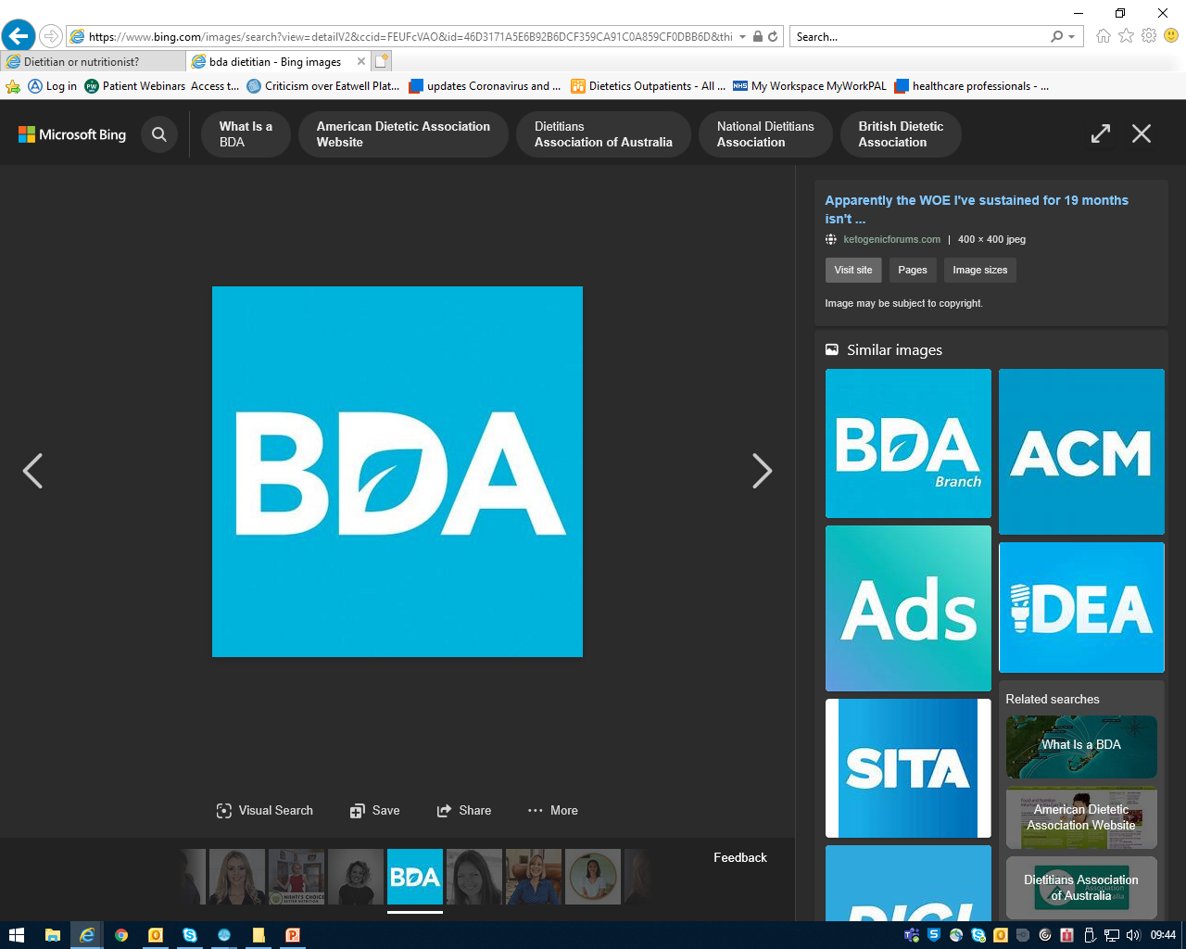
Who are dietitians?
Qualified healthcare professionals
Assess, diagnose and treat dietary and nutritional problems
Governed, protected and registered by the Health & Care Professionals Council (HCPC)
Treat at individual level or the wider public
Use the most up-to-date research → practical guidance
Dietitian or nutritionist?
Regulated by law and governed by an ethical code
Specific qualifications
Quality assured

Slide 3




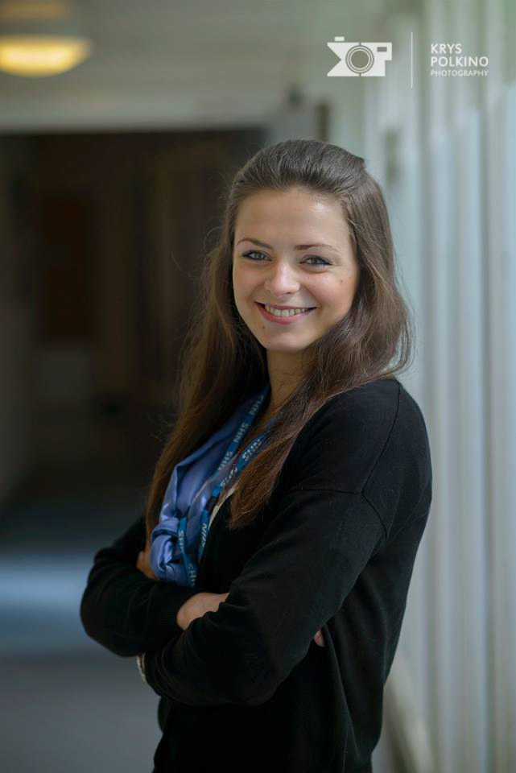
Skills and Experience
Undergraduate/Postgrad degree
  Undergrad in Nutrition and dietetics
  Biological sciences, Neurosciences, Biomedical Sciences and Food Nutrition → PGDip
Experience
  Research
  Clinical
Skills needed
  Interpersonal skills
  Core values of the NHS – the 6 C’s!
  Research (keep up to date!)
  Interested in health and nutrition
  Reflections
  People person!
Care
Competence
Compassion
Communication
Commitment
Courage

Slide 4
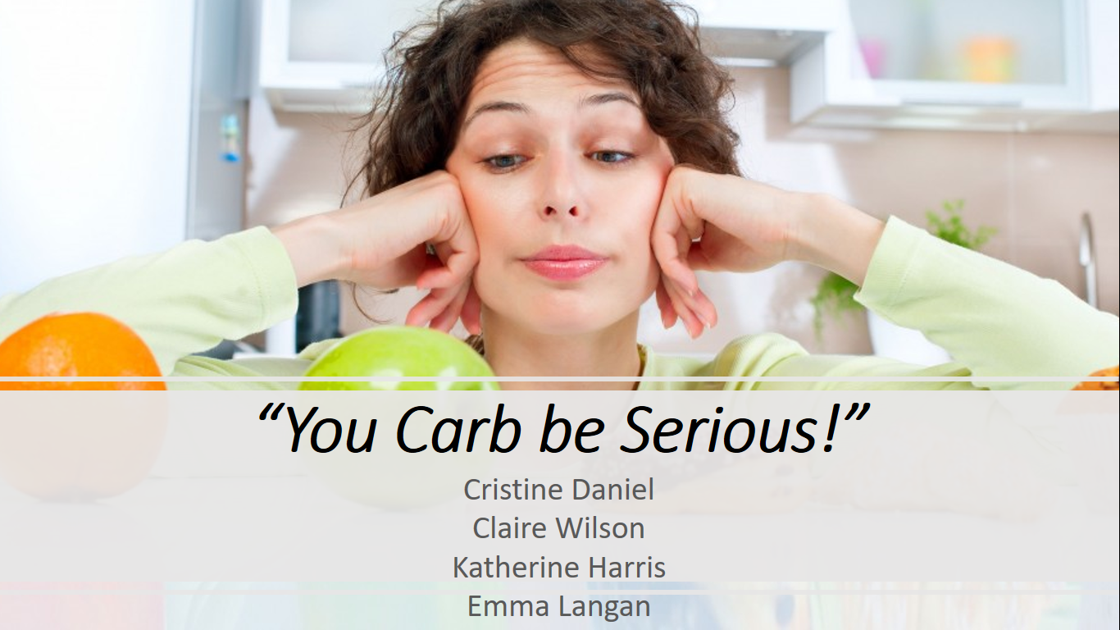
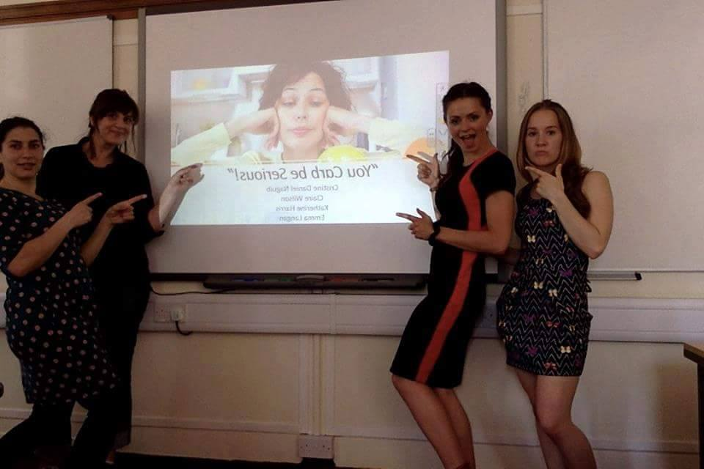
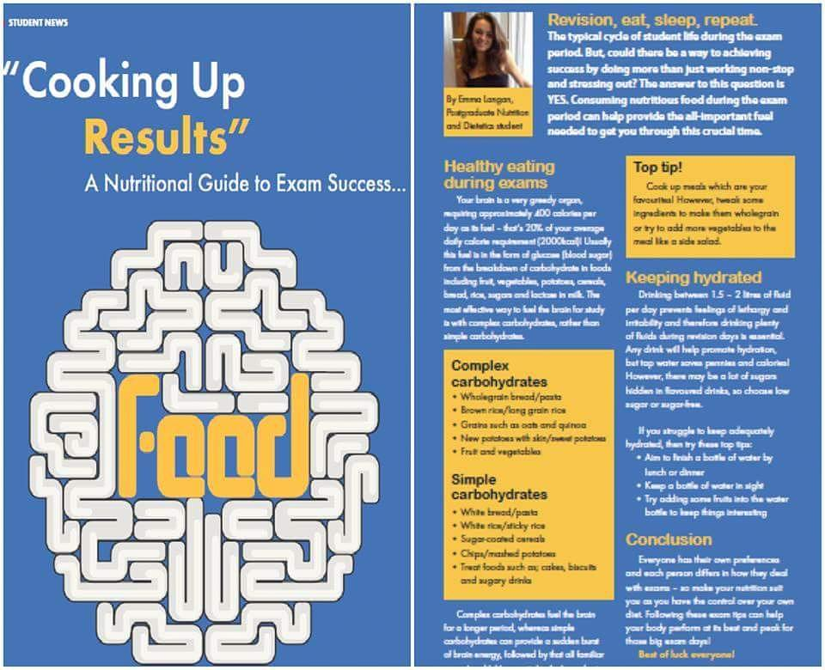
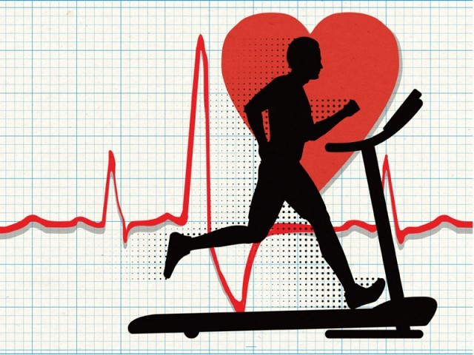
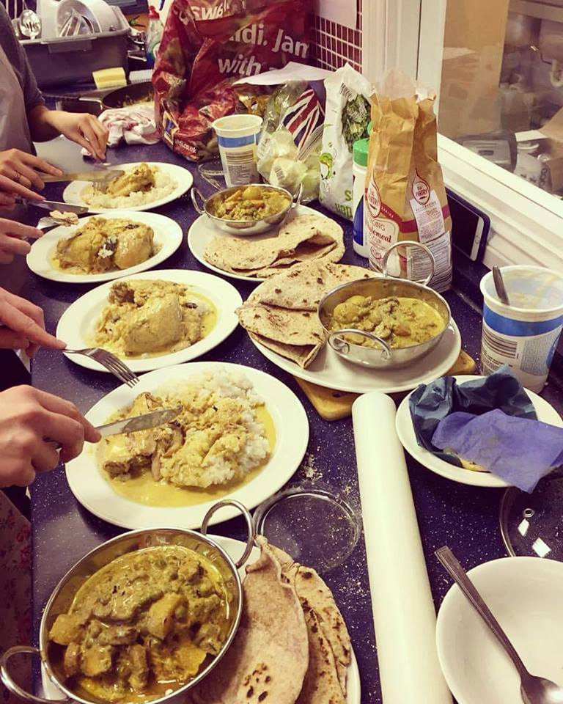
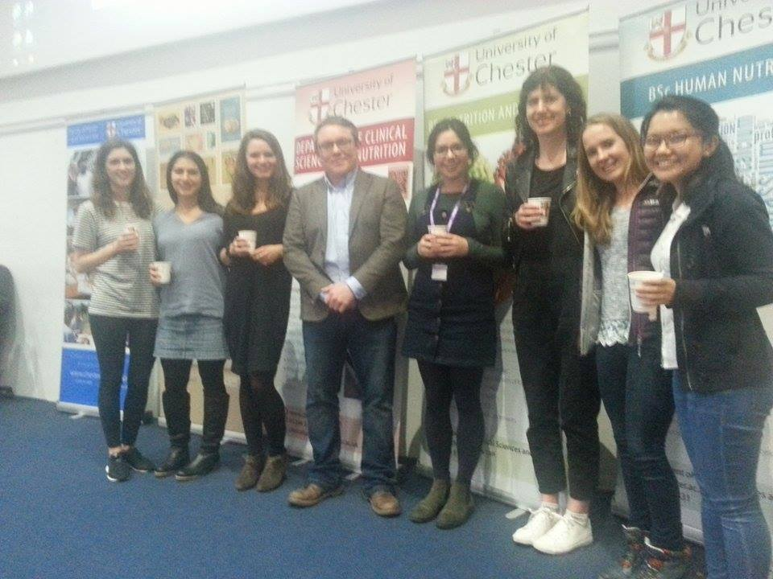
Life as a student dietitian
Modules and exams...
Presentations
Magazine articles
Placements
Expert talks

Slide 5
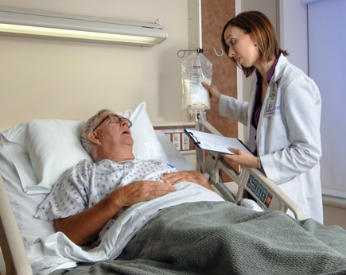
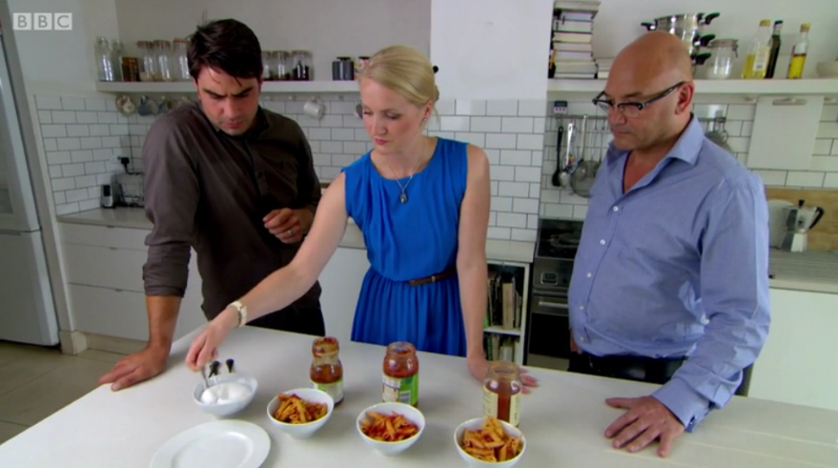

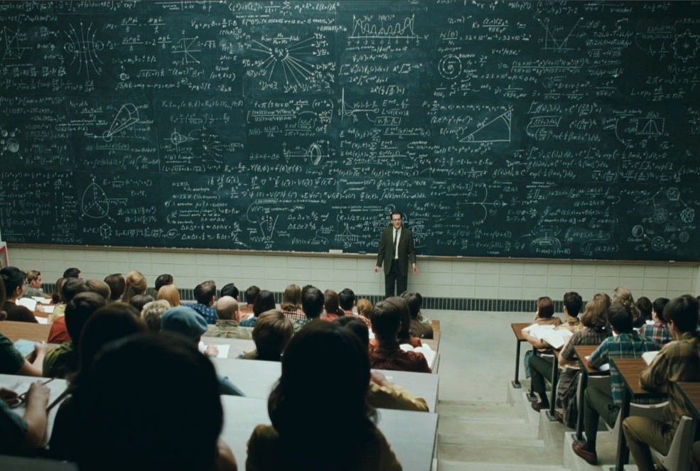

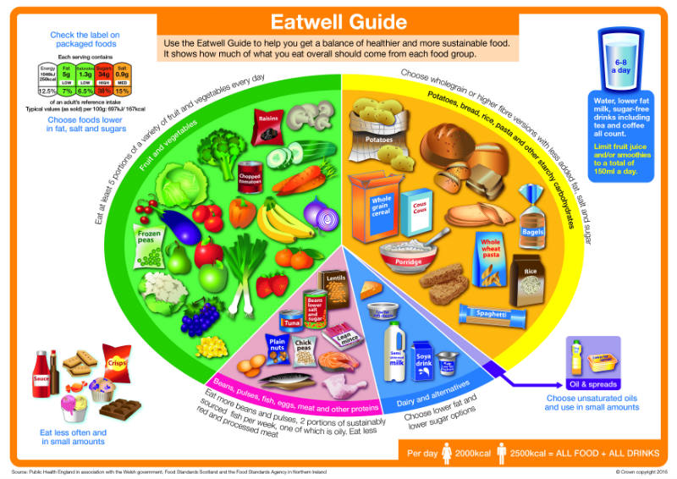


Where can I work as a dietitian?
Acute or community setting:
  Paediatrics
  Gastroenterology
  Renal
  Intensive Care
  Oncology
  Diabetes
Media
Education and research
Food industry
Pharmaceutical industry
Public Health
Sports nutrition…

Slide 6
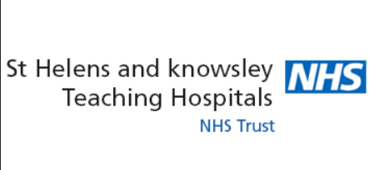
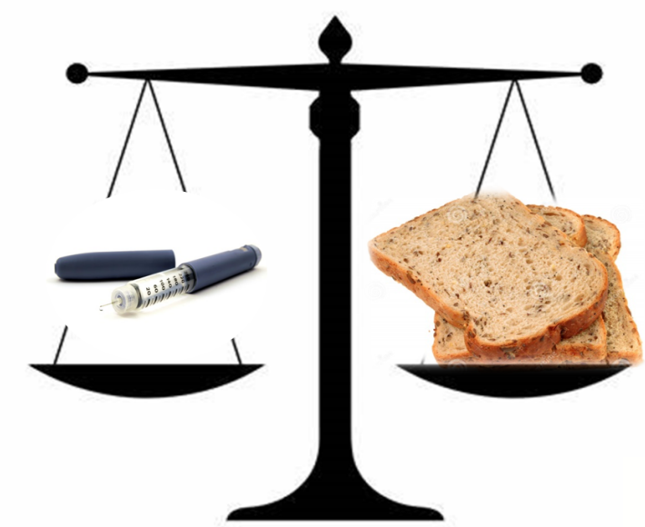
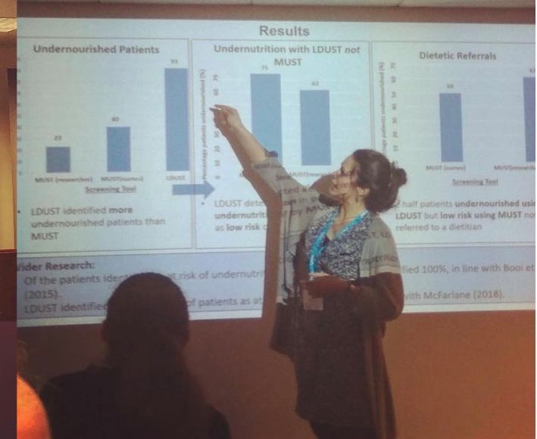
‘Diabetes Specialist Dietitian’
Audit lead
Face to face/ telephone clinics
Education sessions for Type 1/2 Diabetes patients
Working in an MDT
Managing a big caseload
Student supervision
Lots of learning!
‘Vice Chair of NWNW BDA Branch’
Team meetings
Promotion through social media
Organising and hosting events

Slide 7




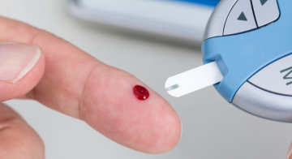
How did I get here?
Biological Sciences
Nutrition and Dietetics
BDA Student Rep
Vice Chair of NWNW BDA branch
Diabetes Specialist Dietitian
Rotational acute dietitian
?
Private work and courses….

Slide 8
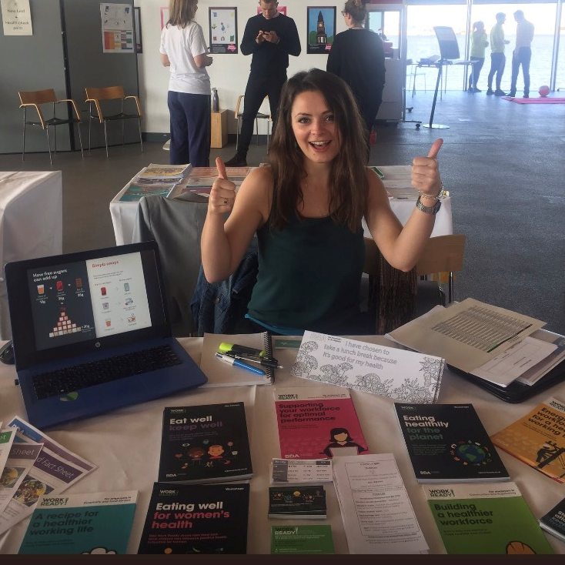
Advice for students…
Start the process now!
Go for what interests you
The job isn’t just in the NHS, start thinking of areas you’d like to work in
There is lots to look forward to if you’re thinking about going into this career
Talk to dietitians and have a discussion about what you can do next
Working well and enjoy studying at university

Slide 9

Any questions?
?

