Slide 1

STUDYING PHYSIOTHERAPY
Liam Parkinson

Slide 2




MY EXPERIENCES…

Slide 3
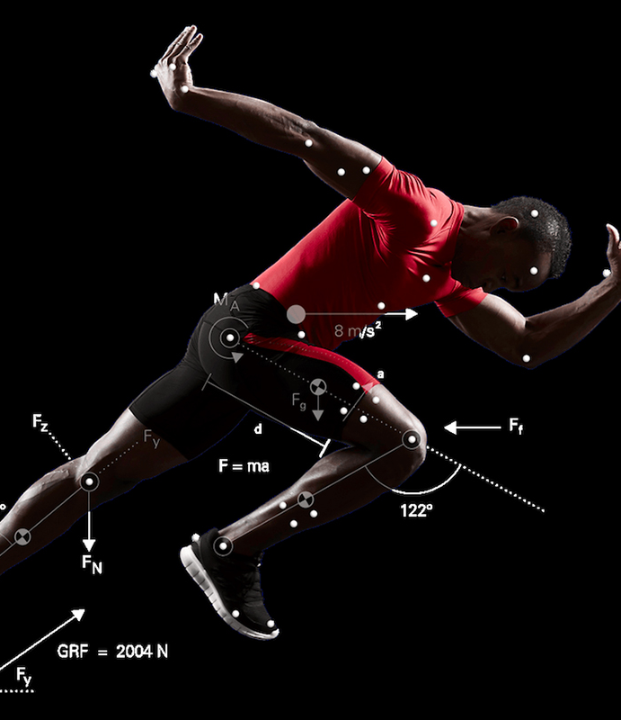
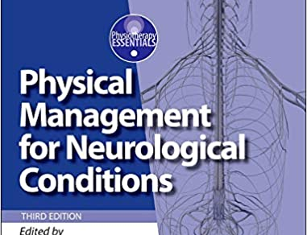
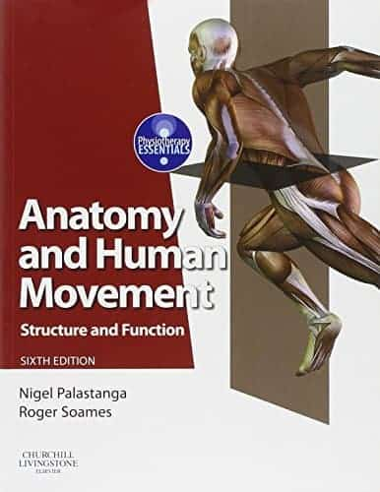
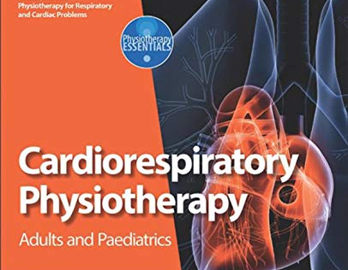
Sport science to physiotherapy
Sport Science: Biomechanics, Anatomy, Human Movement and Cardiovascular Physiology
Physiotherapy: MSK, Neuro, Cardiorespiratory
Practical Placements

Slide 4


undergraduate OR POSTGRADUATE
Application:
BSc (3 year) - UCAS
MSc (2 year) – Direct to university
Funding:
2nd Undergraduate loan (Healthcare exemption)
Postgraduate loan

Slide 5
MSc Programme
Notes:
HCD – healthcare delivery

Slide 7
PLACEMENTS
Practical Placement 0: 4 Days (Observational)
Practical Placement Area 1: 5 weeks BSc/6 weeks MSc
Practical Placement Area 2: 5 weeks BSc/6 weeks MSc
Practical Placement Area 3: 5 weeks BSc/6 weeks MSc
Elective Placement: 4 weeks
* Total 1,000 Hours in order to register with HSPC/CSP *

Slide 8

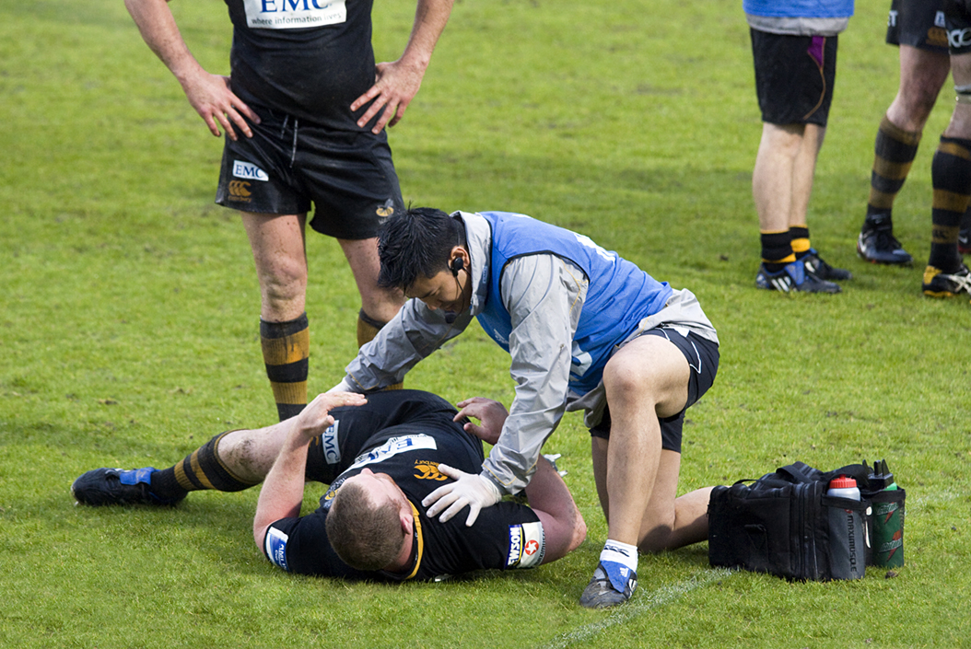

CAREER opportunity

Slide 9





QUESTIONS?
Liam Parkinson
Liam.Parkinson2@stu.mmu.ac.uk

